Slide 1
EECS 498 System Design of a Search Engine
Winter 2026
Lab 10: Intro to Google Cloud Platform
GSI: Christopher Davis
IA: Rickey Dong
Nicole Hamilton
https://web.eecs.umich.edu/~nham/
nham@umich.edu

Slide 2
Agenda
Redeeming credits
Logging into GCP
Creating a Virtual Machine instance in Compute Engine
Adding SSH Keys
Installing dependencies
Running your LinuxGetSsl application
Stopping / Suspending / Starting / Deleting instances

Slide 3
Agenda
Redeeming credits
Logging into GCP
Creating a Virtual Machine instance in Compute Engine
Adding SSH Keys
Installing dependencies
Running your LinuxGetSsl application
Stopping / Suspending / Starting / Deleting instances

Slide 4
Redeeming Credits
If you have not yet redeemed GCP Education credits, let’s do so now
Fill out the form in EdStem Post#79 where each student uses their email
You will receive an email in your inbox to verify your account. Verify
You will receive an email in your inbox with the coupon code
Redeem this coupon code at https://console.cloud.google.com/edu

Slide 5
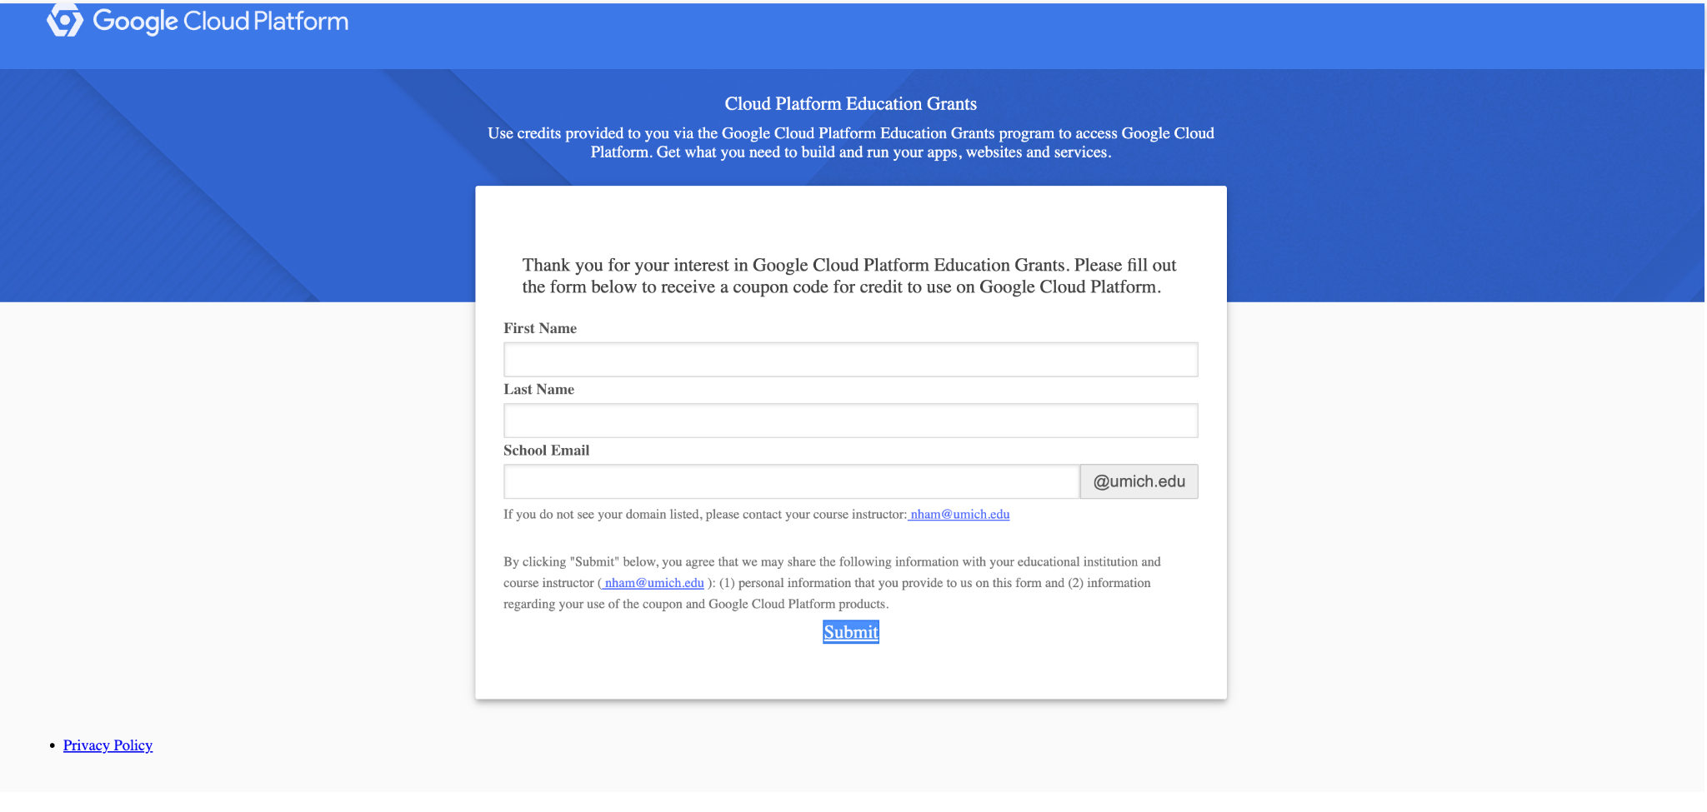
Fill out this form with each student using their own email

Slide 6
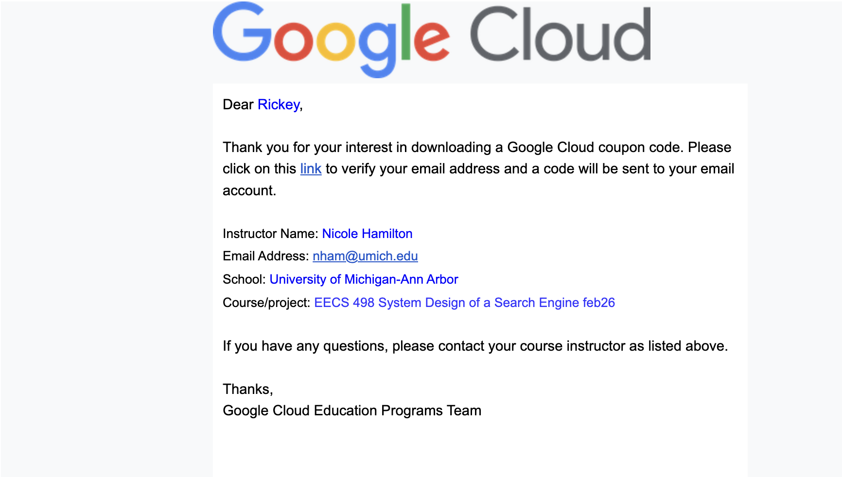
2. Verify your email

Slide 7
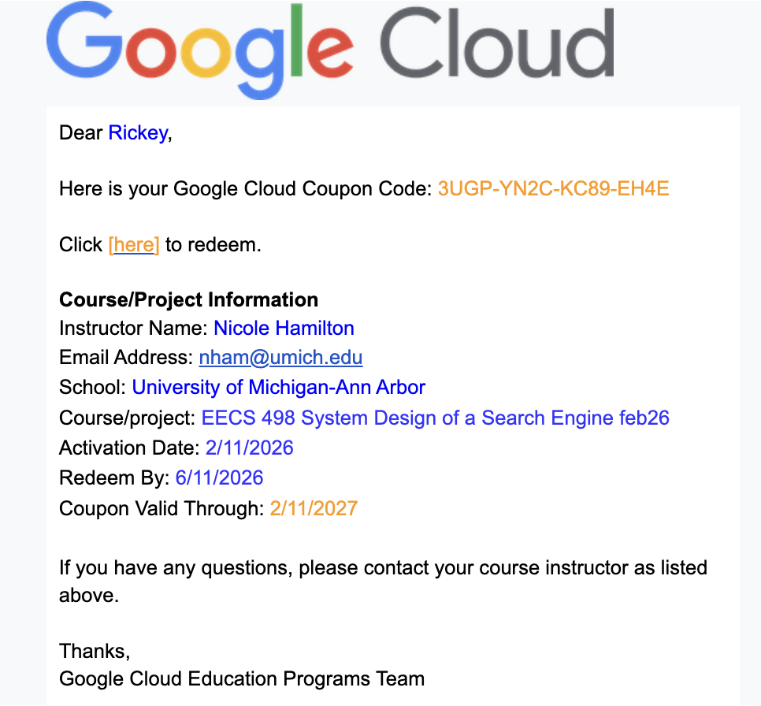
3. Receive the coupon code

Slide 8
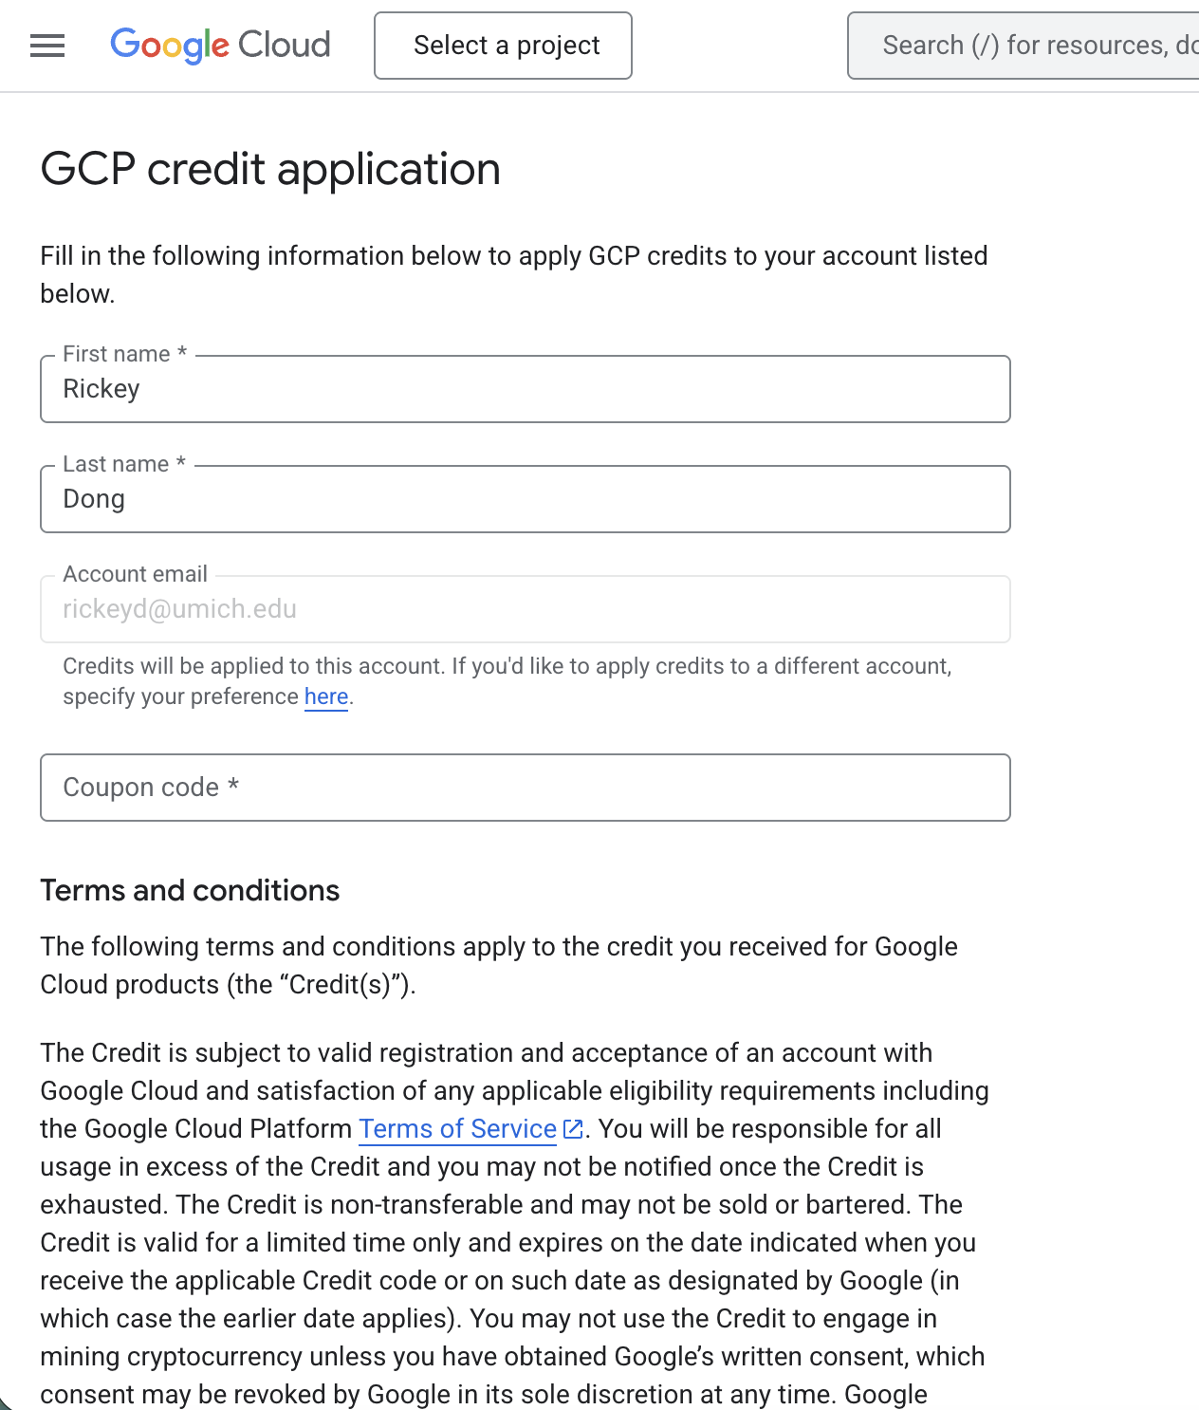
4. Redeem the coupon code

Slide 9
Agenda
Redeeming credits
Logging into GCP
Creating a Virtual Machine instance in Compute Engine
Adding SSH Keys
Installing dependencies
Running your LinuxGetSsl application
Stopping / Suspending / Starting / Deleting instances

Slide 10
Signing In
First, look up “GCP console” or go to: https://console.cloud.google.com/

Slide 11
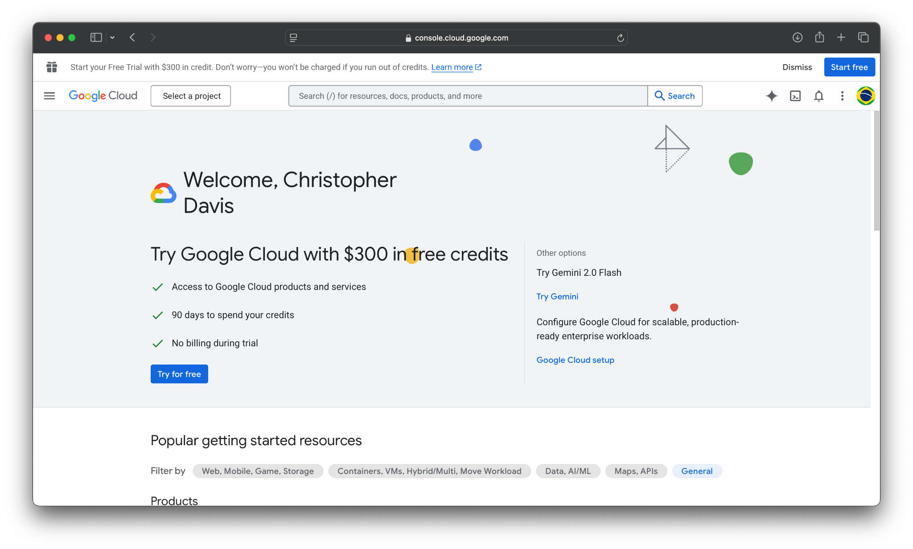

Slide 12
Signing In
First, look up “GCP console” or go to: https://console.cloud.google.com/
Note: in addition to the student credits, each new GCP account can claim $300 in free credits!
That’s at least $1500 - $1800 in completely free credits!

Slide 13
Project
Now, we will create a GCP project.
Projects encapsulate all the cloud services used for a given application.
Can view consolidated billing and set budgets
Monitor CPU / memory / storage usage
Let’s create our own project on the GCP console.

Slide 14



Slide 15
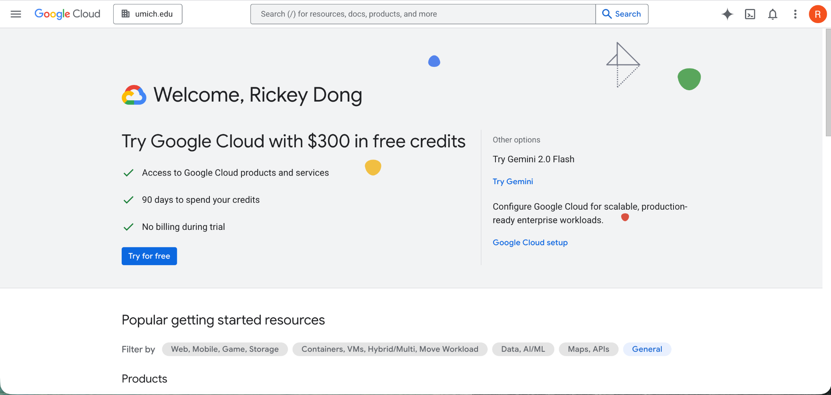
If you’re using the student credit, it might look like this.

Slide 16
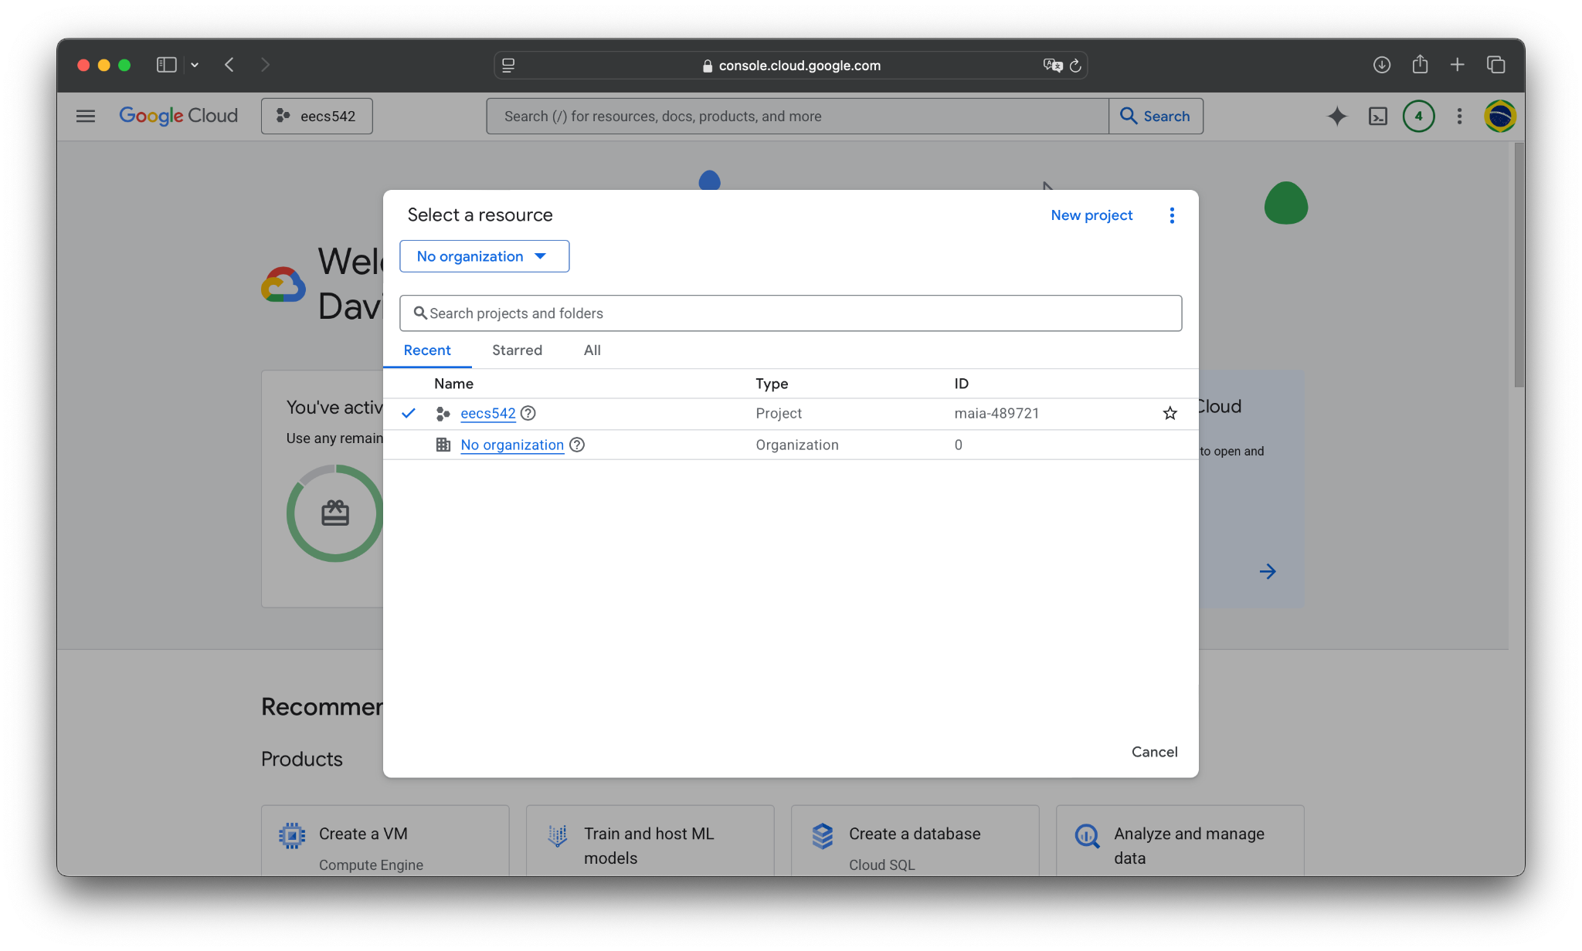

Slide 18
Project
Now, we will name and configure your project.
A project has the following fields:
Name: the name of your project.
Organization: the organization your project is under, which tells GCP how to organize billing. This will be umich.edu if using the student credit.
Parent resource: which billing resource to actual send invoices to.

Slide 19
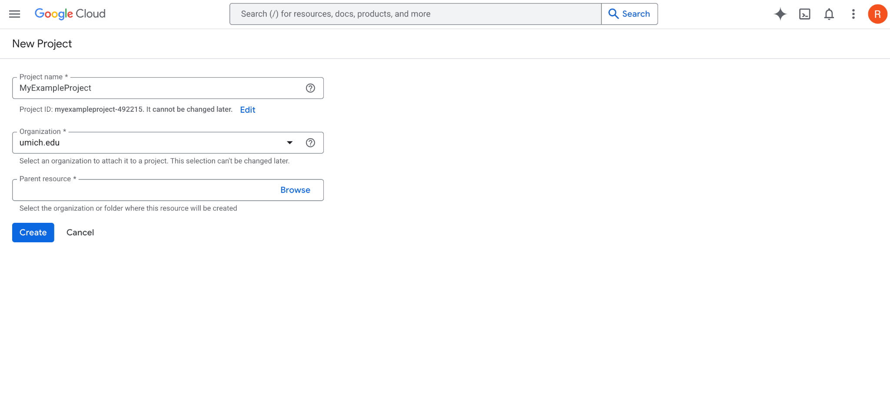
Project name.

Slide 20
Organization. Should be umich.edu if on student credit.

Slide 21
Now we set the resource within the organization (for student credit).

Slide 22
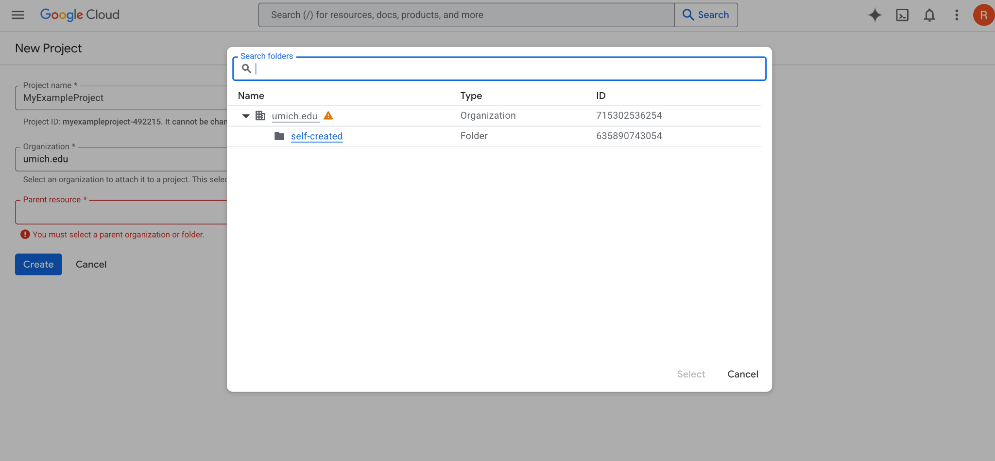
It will be umich.edu > self-created

Slide 23
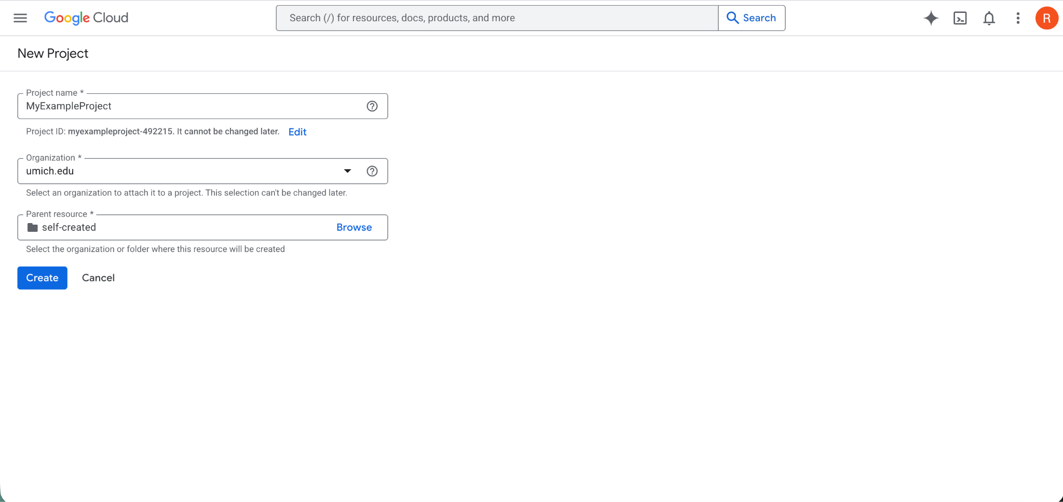
This is the final configuration for a student credit project.

Slide 24
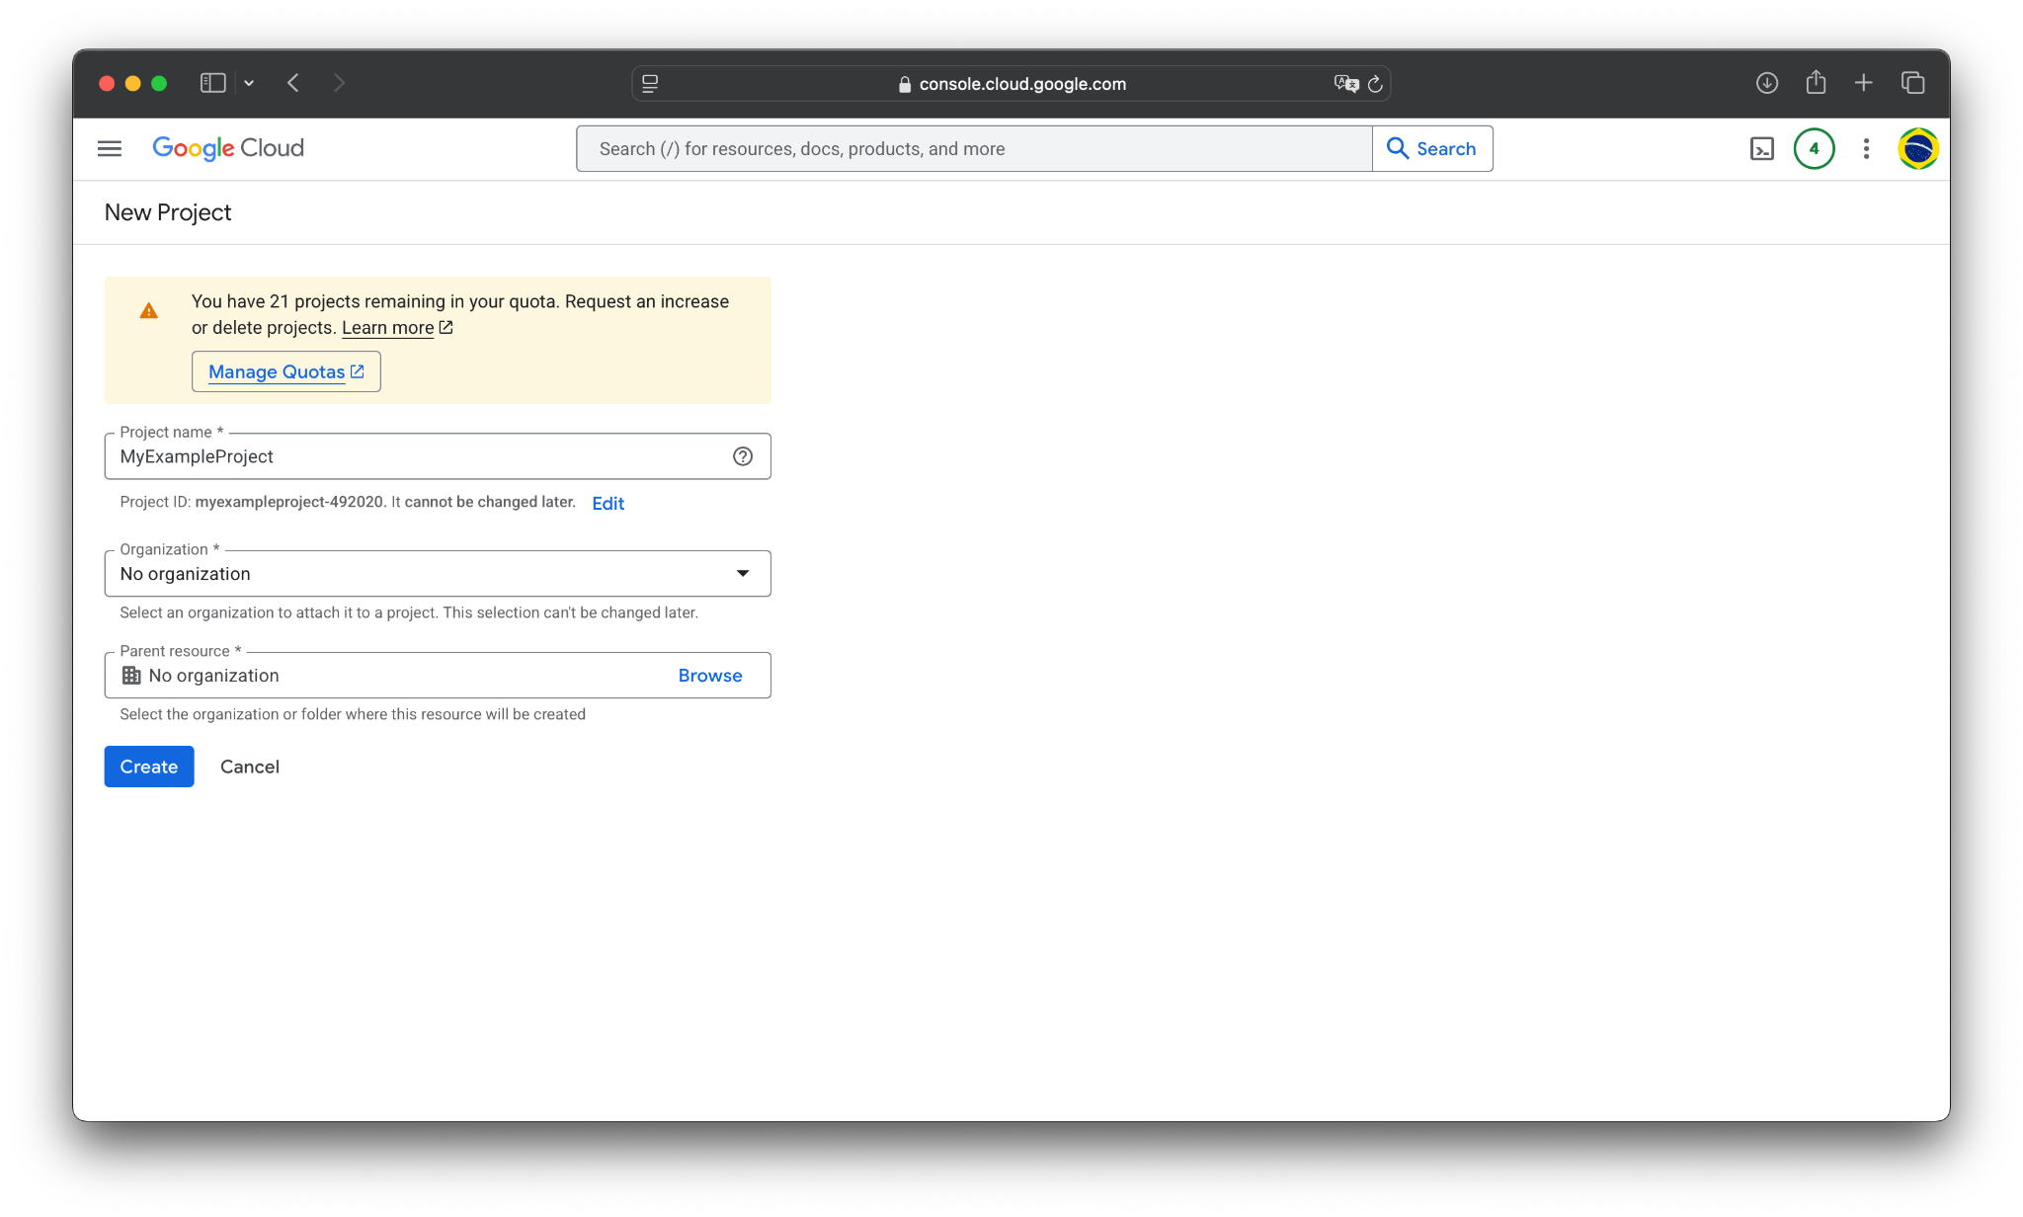
Alternatively, if you’re on the free credit, you don’t need to worry about organization or resource for now.

Slide 25
Hit Create to make the project.

Slide 26
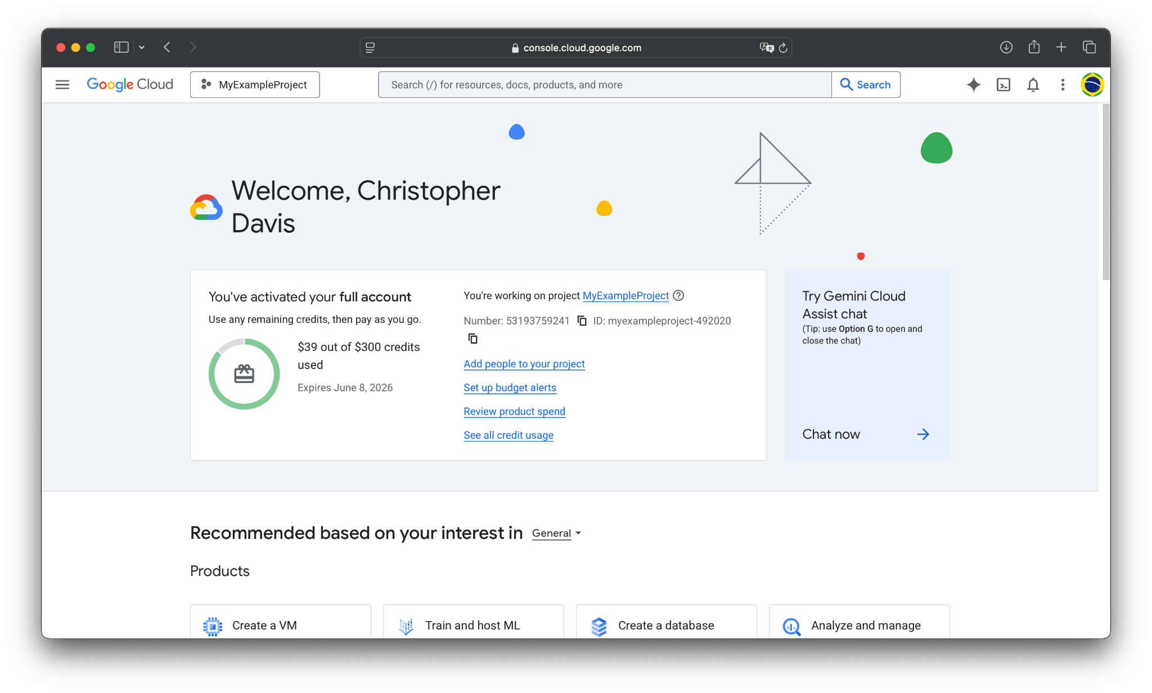
This is your current project;
make sure it’s the right one.

Slide 27
Agenda
Redeeming credits
Logging into GCP
Creating a Virtual Machine instance in Compute Engine
Adding SSH Keys
Installing dependencies
Running your LinuxGetSsl application
Stopping / Suspending / Starting / Deleting instances

Slide 28
Creating a VM Instance
Let’s create our first Virtual Machine (VM) instance.
VMs are created through the GCP Compute Engine service
They are the most basic computing / server units for GCP
  Equivalent to AWS EC2

Slide 29
Creating a VM Instance
The steps to make one are as follows:
Activate Compute Engine (if it’s your first time)
Create an instance – specify vCPUs, RAM, OS, and storage type & amount

Slide 30
Creating a VM Instance
The steps to make one are as follows:
Activate Compute Engine (if it’s your first time)
Create an instance – specify vCPUs, RAM, OS, and storage type & amount

Slide 31
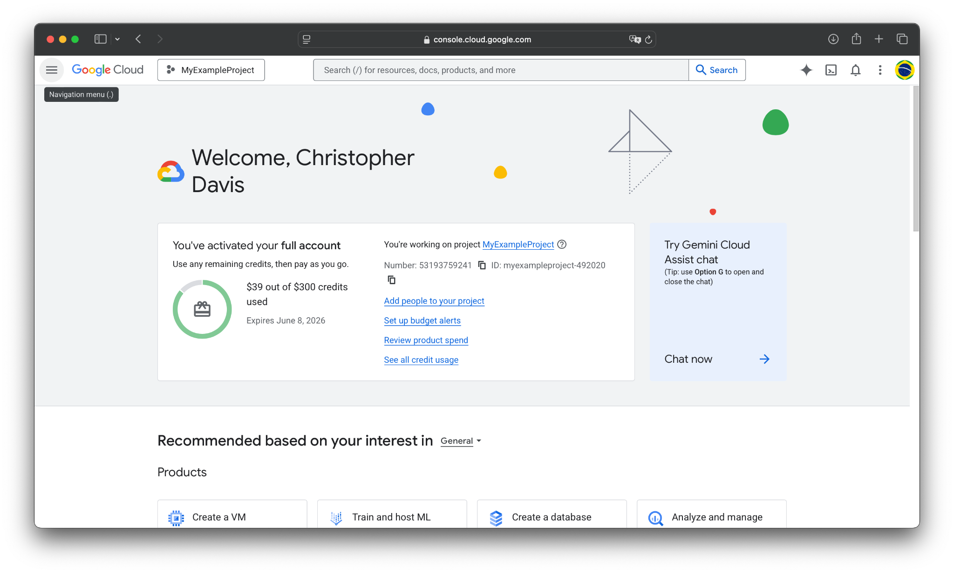
Open the sidebar here.

Slide 32
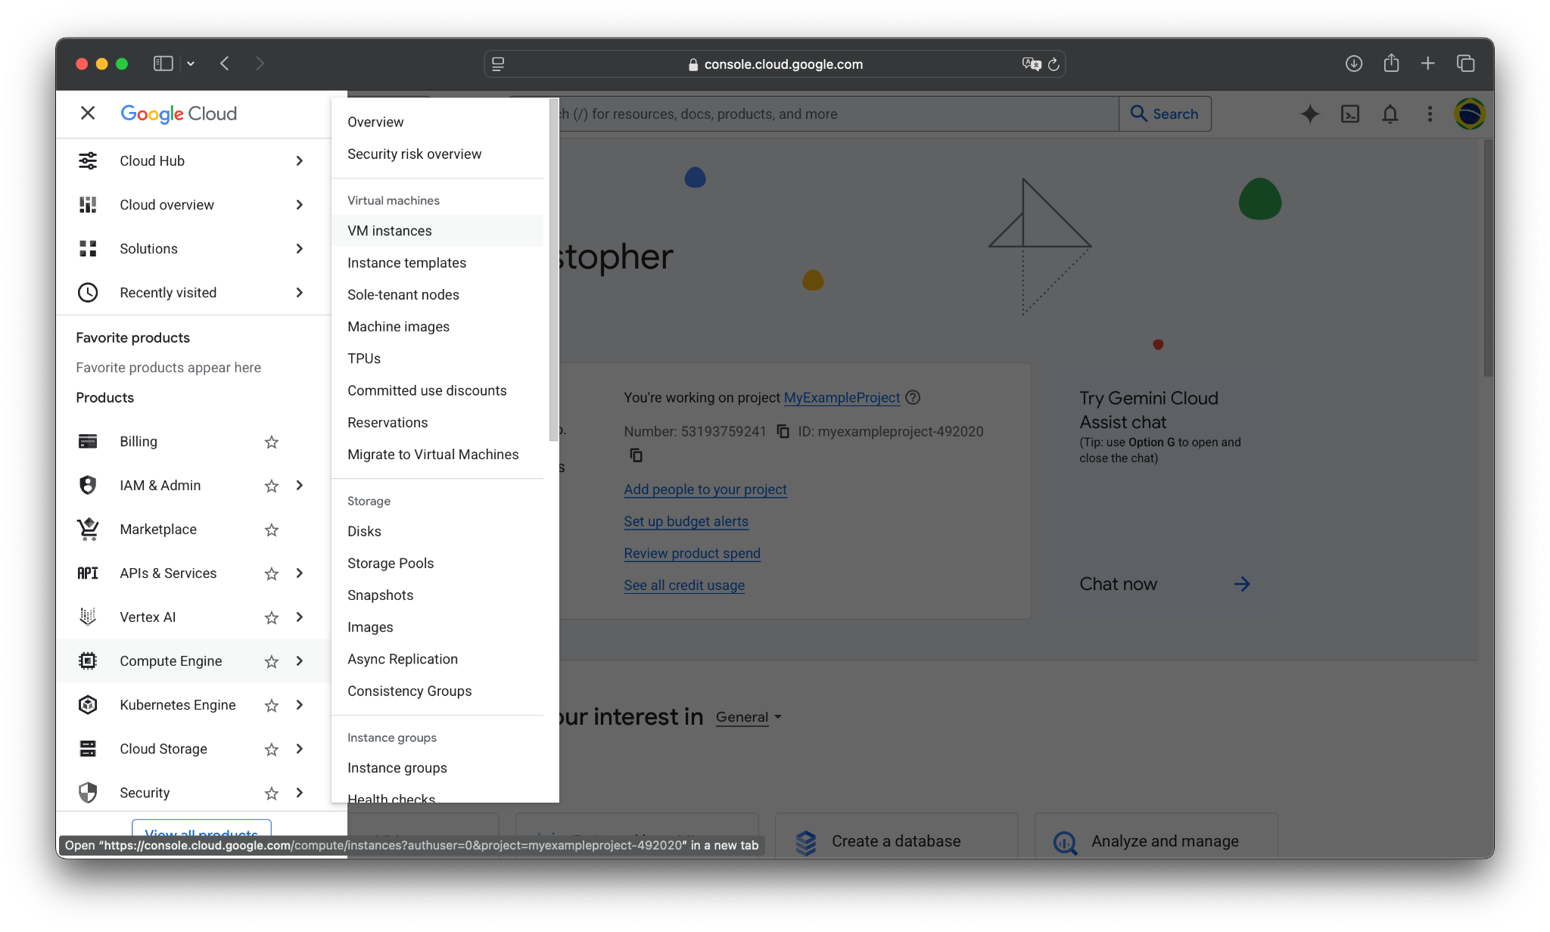
Hover over Compute Engine, then click on VM instances.

Slide 33
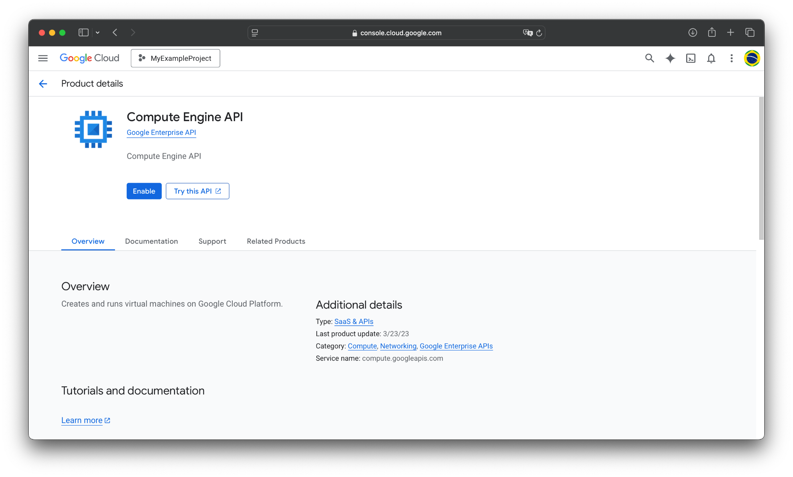
If this is your first time for this project, you will see this screen.
Click Enable, and then wait for it to load. It may take a minute to finish.

Slide 34
If this is your first time for this project, you will see this screen.
Click Enable, and then wait for it to load. It may take a minute to finish.
You might need to reload the page after a minute or two.

Slide 35
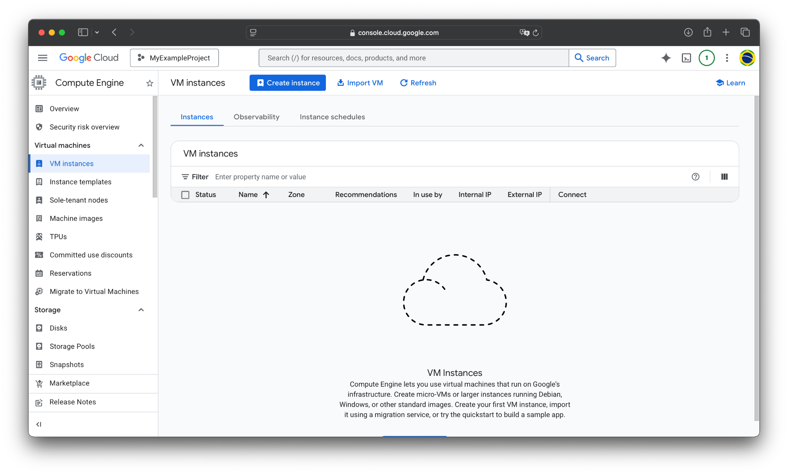
After waiting (and perhaps reloading and going back to Compute Engine > VM Instances), you will see this screen.

Slide 36
Creating a VM Instance
The steps to make one are as follows:
Activate Compute Engine (if it’s your first time)
Create an instance – specify vCPUs, RAM, OS, and storage type & amount

Slide 37
Creating a VM Instance
Now that the Compute Engine API has been enabled, we can create our first VM instance!
We can specify:
Class of CPUs/hardware
Number of vCPUs and amount of memory
OS distribution and version
Storage type and amount
Networking and firewalls
IO interfaces, GPUs, etc.

Slide 38
Click Create instance.

Slide 39
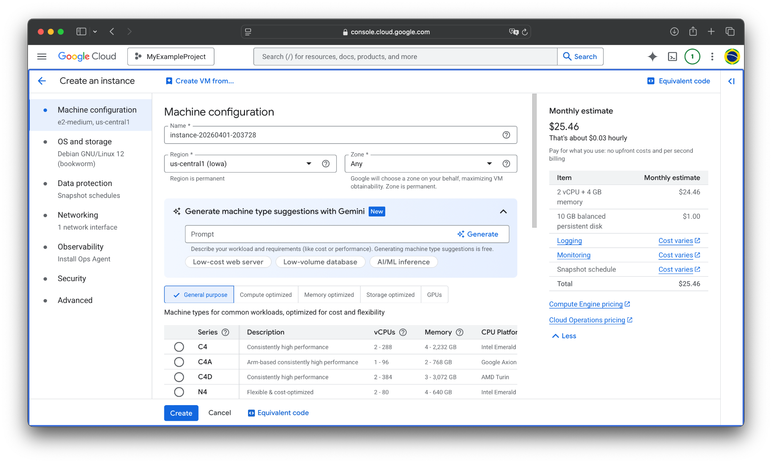
You will get this menu.

Slide 40
Creating a VM Instance
On this menu, we will be able to:
Name our instance
Set its region and zone
Select the series of machine and its hardware
Choose our OS and storage

Slide 41
Creating a VM Instance
On this menu, we will be able to:
Name our instance
Set its region and zone
Select the series of machine and its hardware
Choose our OS and storage

Slide 42
You can set a name for the instance here.
You can just use the default name for the demo.

Slide 43
Creating a VM Instance
On this menu, we will be able to:
Name our instance
Set its region and zone (i.e., which datacenter it’s located in)
Select the series of machine and its hardware
Choose our OS and storage

Slide 44
You can select a region here. Just use the default (e.g., us-central1, as it’s the closest to us, and not too crowded).

Slide 45
You can keep Zone as “Any” for now.

Slide 46
Creating a VM Instance
On this menu, we will be able to:
Name our instance
Set its region and zone (i.e., which datacenter it’s located in)
Select the series of machine and its hardware
Choose our OS and storage

Slide 47
Series of machine.

Slide 48
Creating a VM Instance (Series)
Machine series are categorized groupings of VM presets designed for particular workloads. They have different CPU hardware, different ranges for vCPU counts and memory, and different storage options.
For example:
General Purpose: N4, N2, N2D, E2
  Everyday workloads like web servers, dev environments, etc.
Compute Optimized: C2, C3, C4, H3
  High performance computing; high clock speeds
Memory Optimized: M1, M2, M3, M4
  Suited for large, in-memory databases; high memory to vCPU ratio
Accelerator Optimized: G2, A2
  GPUs for deep learning

Slide 49
Creating a VM Instance (Series)
We only need something cheap for this tutorial, so let’s choose the E2 (General Purpose) VM class.
Beyond the series, we can also choose the type of machine. I.e., configure the exact number of vCPUs and memory.
We can choose between a number of presets, or select custom values ourselves. Let’s use a simple preset.

Slide 50
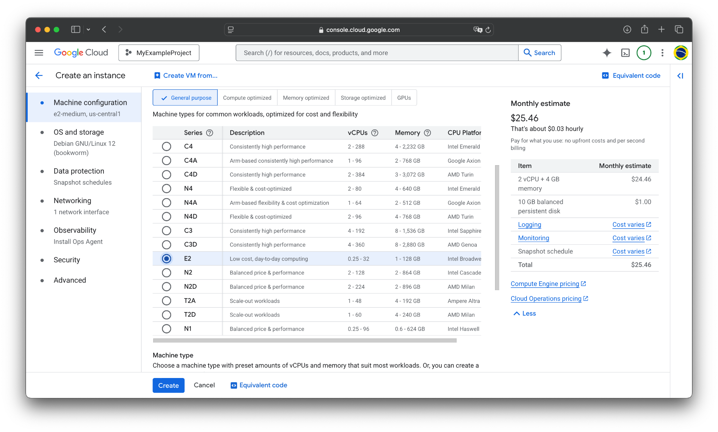
Scroll down to see all the series.

Slide 51
Scroll down to see all the series.
We want series E2.

Slide 52
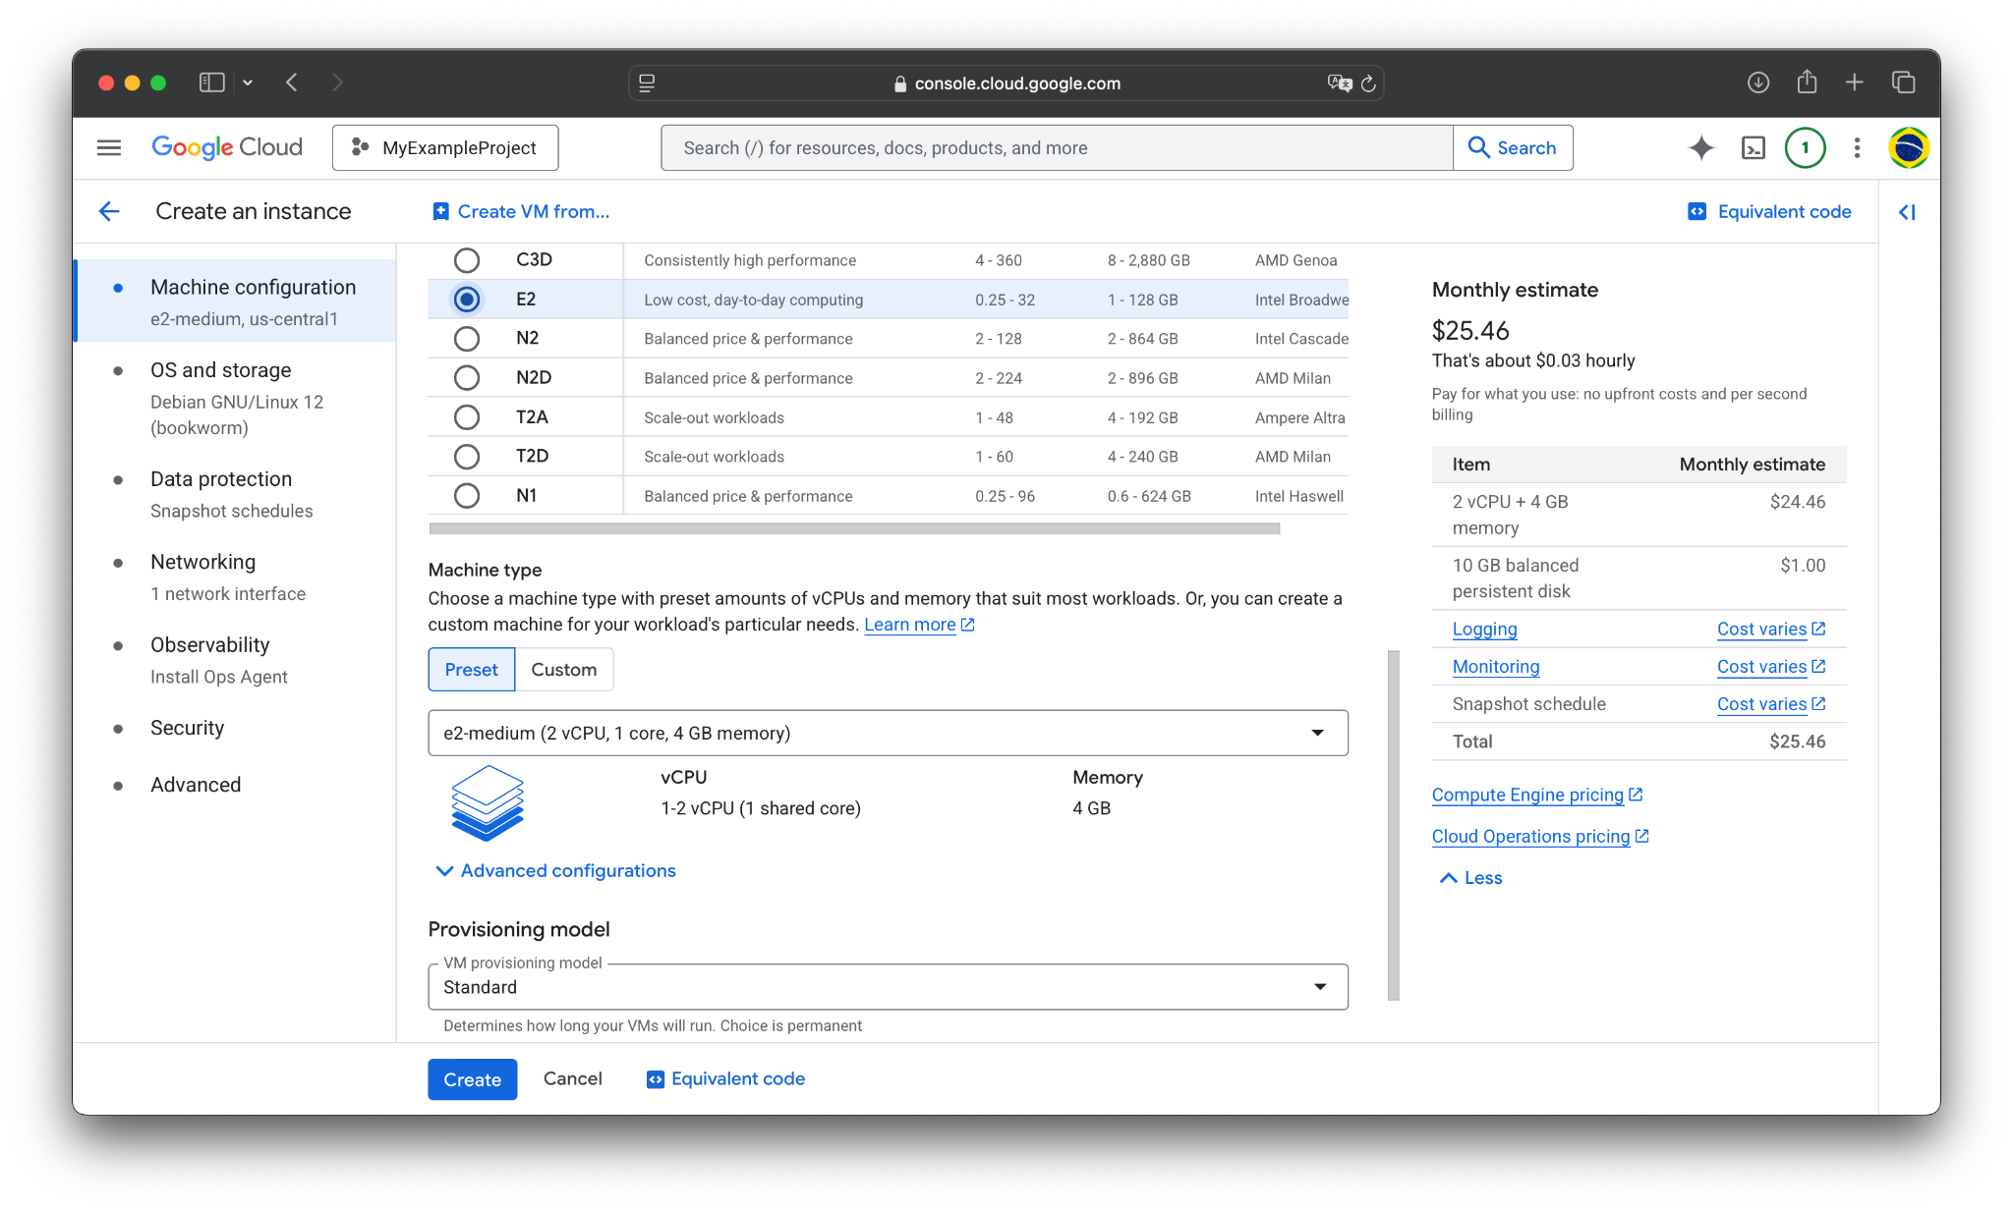
We want series E2.
Click here to choose a vCPU/RAM preset.

Slide 53
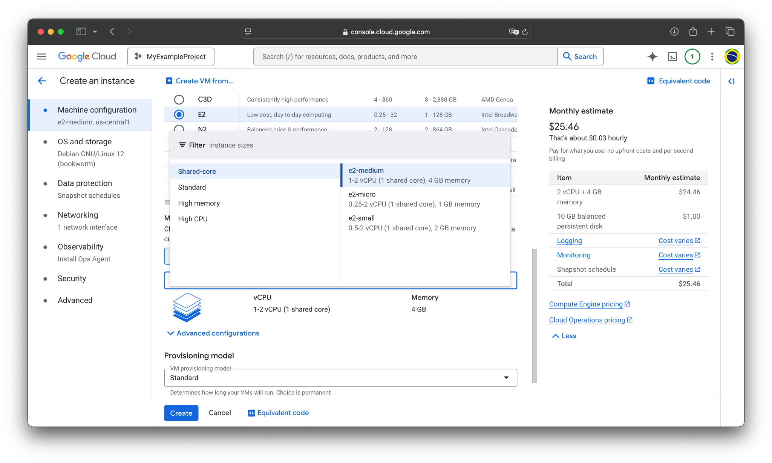

Slide 54
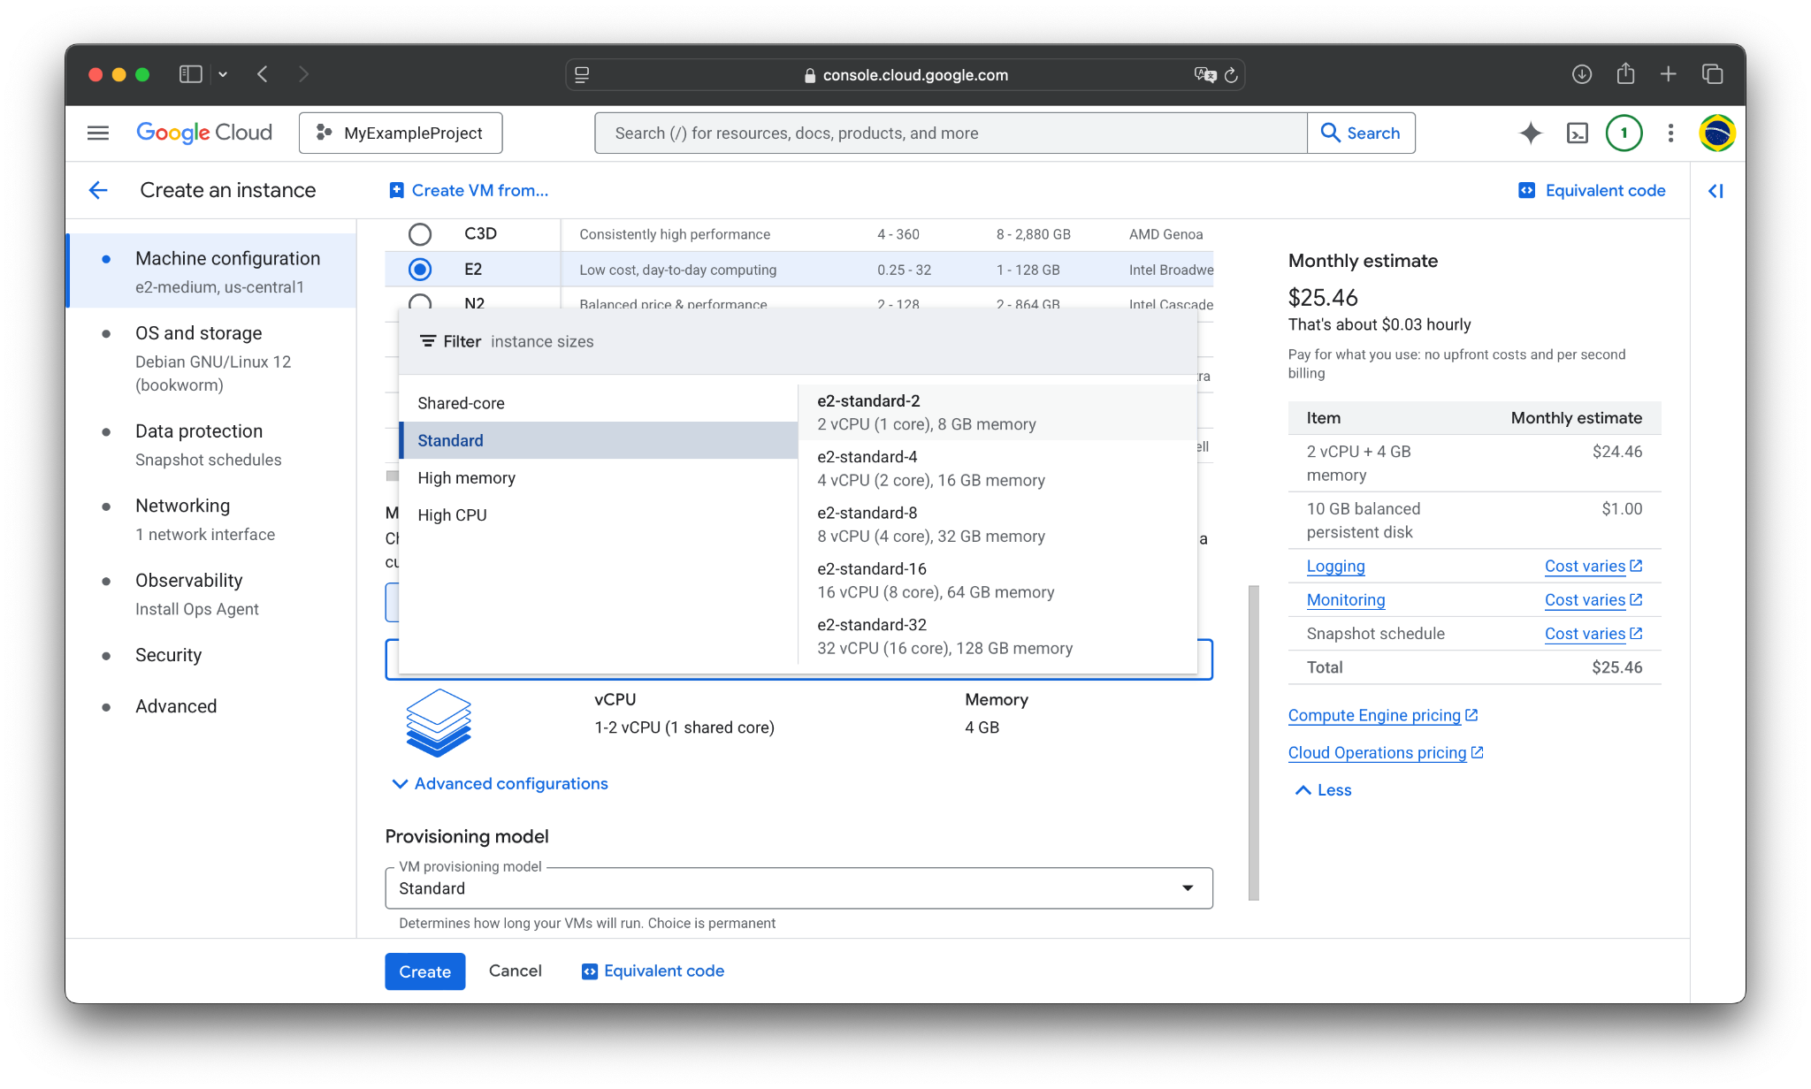
Select Standard > e2-standard-2

Slide 55
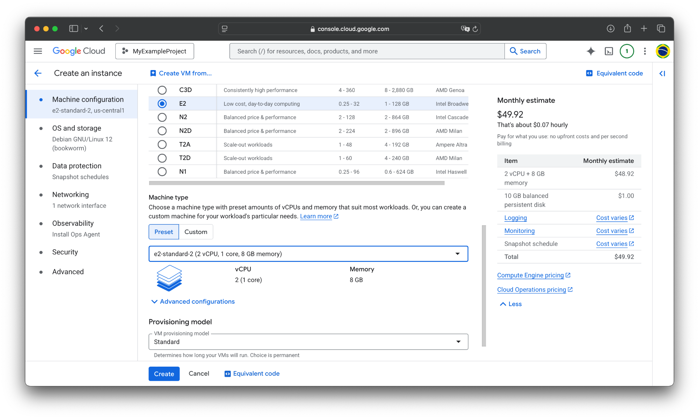
Current configuration.
We want e2-standard-2.

Slide 56
You can see the (estimated) billing cost for your machine type here.
Both hourly and monthly.

Slide 57
You can see an itemized breakdown below.

Slide 58
Creating a VM Instance (Type)
In the above example, I showed:
e2-standard-2 (2 vCPU, 1 core, 8 GB memory), for $49.92 / month
Consider another machine configuration:
n2-standard-16 (16 vCPU, 8 cores, 64 GB memory), for $567.17 / month
That’s a big difference in price!
You have to choose your machines carefully, balancing cost vs performance
There are other ways to minimize cost, which we’ll cover later
For now, just select the cheap option (e2-standard-2)!

Slide 59
Creating a VM Instance
On this menu, we will be able to:
Name our instance
Set its region and zone (i.e., which datacenter it’s located in)
Select the series of machine and its hardware
Choose our OS and storage

Slide 60
Creating a VM Instance (OS / Storage)
We have selected the compute resources—CPU and RAM—for our VM instance.
Now, we need to specify the OS and storage type / amount we desire.
GCP supports a number of preset OS images, and it is even possible to use your own custom baked image (more on that in a later guide).

Slide 61
Click on OS and storage in the sidebar.

Slide 62
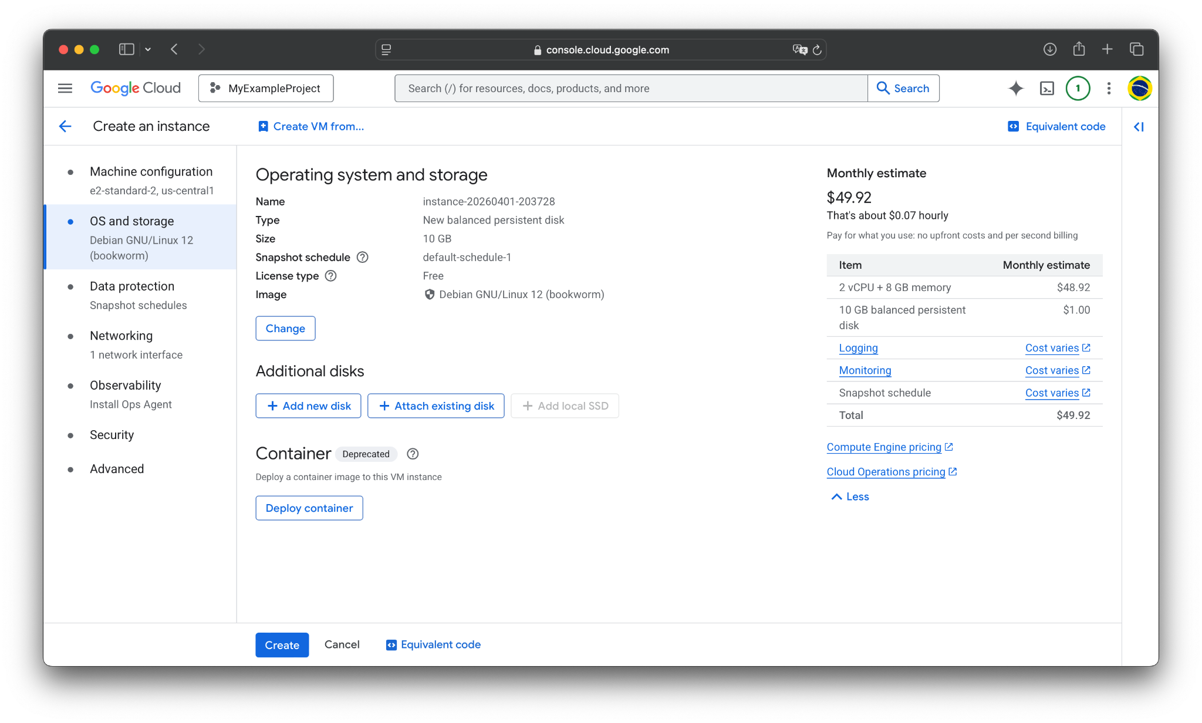

Slide 63
Click here to change the OS and boot disk type.

Slide 64
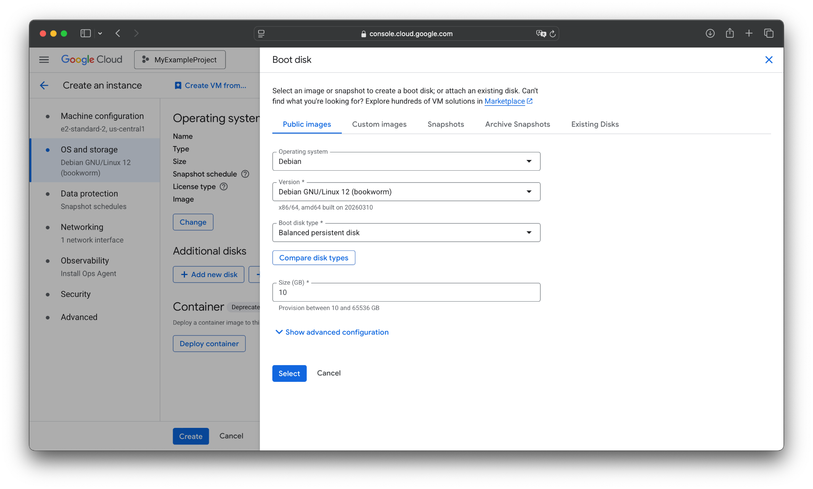

OS and version.

Slide 65
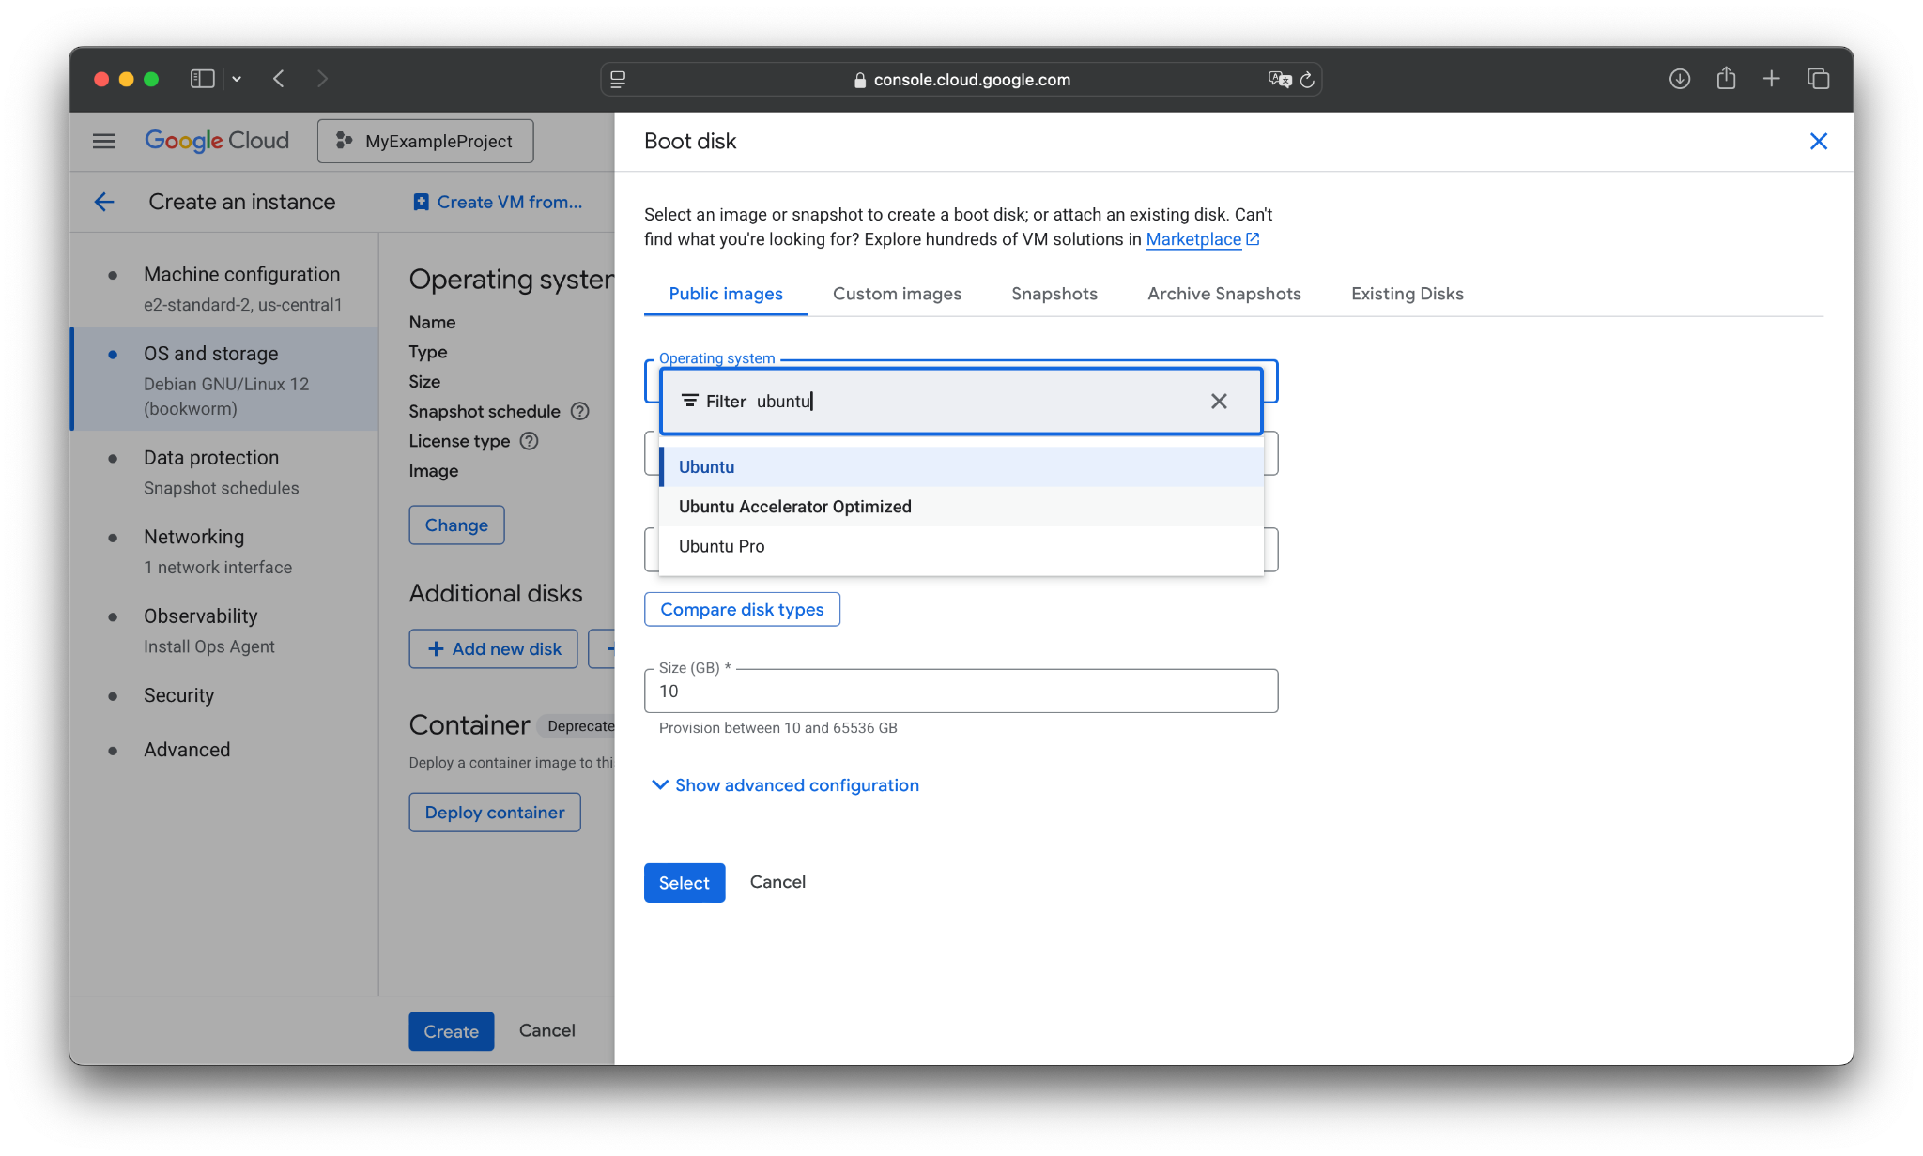
Let’s use Ubuntu for the demo. Scroll down or filter and select it.

Slide 66

Leave the version as default.

Slide 67
Creating a VM Instance (OS / Storage)
For now, let’s choose Ubuntu: Ubuntu 25.10 (Minimal).
The next thing to do is to set the (boot disk) storage type and size.
GCP supports a number of disk types; however, the exact types available to you depend on your VM’s class (C2 vs N2 vs G2 vs etc.).
I will give an overview of the basic ones.

Slide 68
Here are the primary GCP disk types:
Persistent Disks (Network-Attached)
These persist beyond the life of the instance, meaning data stays even if the VM is stopped or deleted (more on that later)
Standard Persistent Disk: backed by HDD; slow but cheap
Balanced Persistent Disk: backed by SSD; good for general purpose usage
SSD Persistent Disk: backed by SSD; high performance and low-latency
Extreme Persistent Disk: SSD-based performance; more control over throughput scaling
Local SSD (NVME)
Physically attached to machine. Lowest latency + highest IOPS
However, it is ephemeral — data is lost when the VM is stopped or deleted (!!!)
Hyperdisk
Next-generation block storage that lets you independently scale capacity, IOPS, and throughput to optimize performance and reduce costs.

Slide 69
Let’s change the disk type.

Slide 70
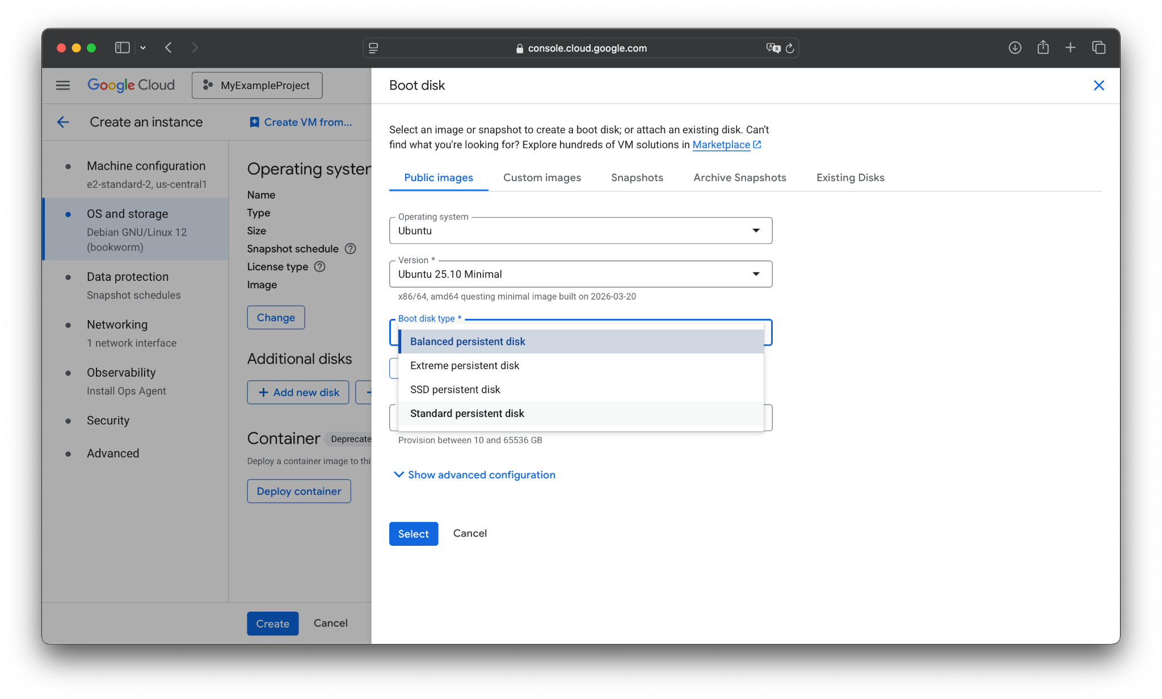
We will just use standard persistent disk for the demo.

Slide 71
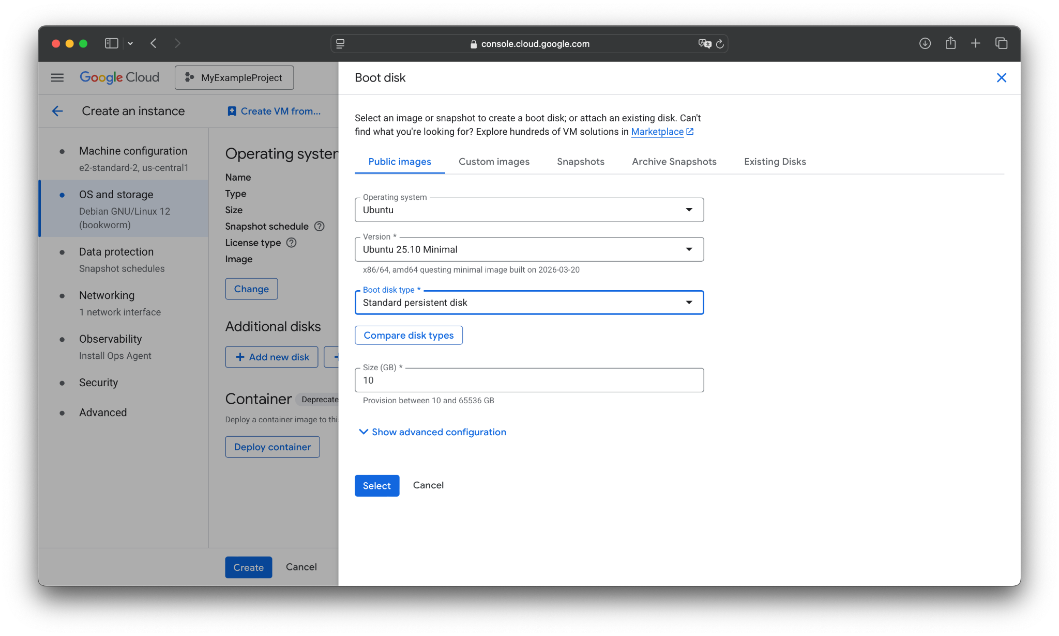
Can change disk size here. The default (10 GB) is enough for the demo.

Slide 72
Press Select to finalize our OS & boot disk selection.

Slide 73


Slide 74
Can add additional disks here, separate to the boot disk.
E.g., a local SSD for scratch data (if your series supports it), or an existing disk.

Slide 75
Creating a VM Instance (Networking)
We have now finished configuring our VM instance.
As you might have noticed, there are a lot of other tabs and “advanced” configuration options. For the most part (and especially right now), you don’t have to worry about them.
There is one slight exception that matters for later in the course:
The firewall (and outside HTTP/S traffic)
If you want to accept incoming outside requests (e.g., your front-end webserver), then you need to enable HTTP/S in the firewall settings, located in the Network tab.

Slide 76
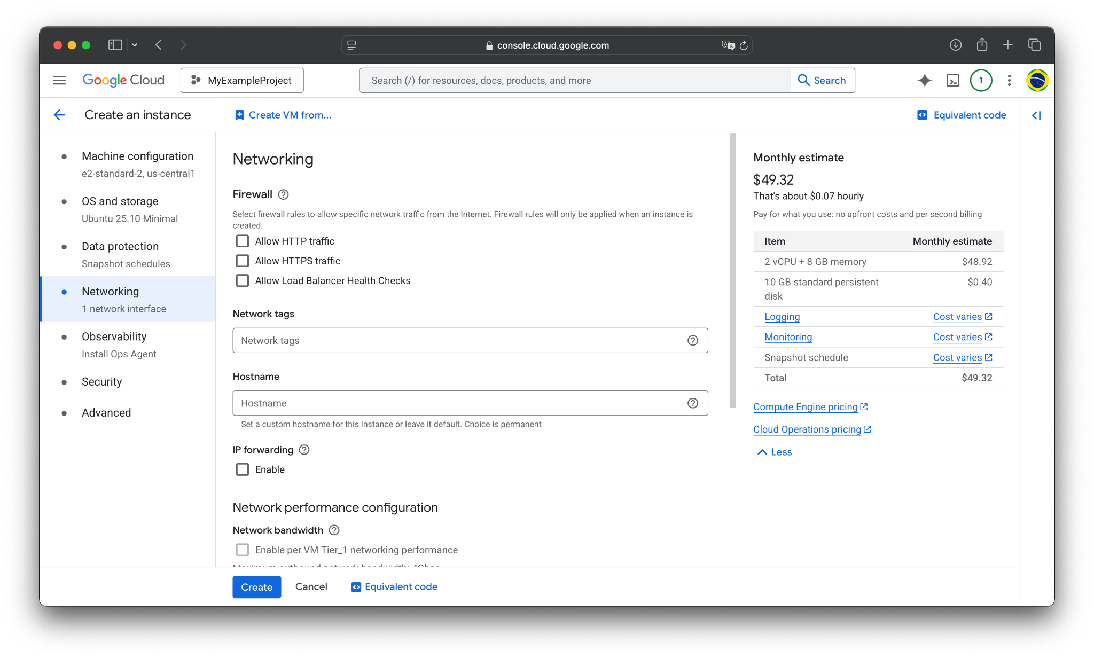
You would select Allow HTTP(S) traffic for a web-server. The demo (and your crawler) doesn’t need this, since it only sends requests. For security, leave it off.

Slide 77
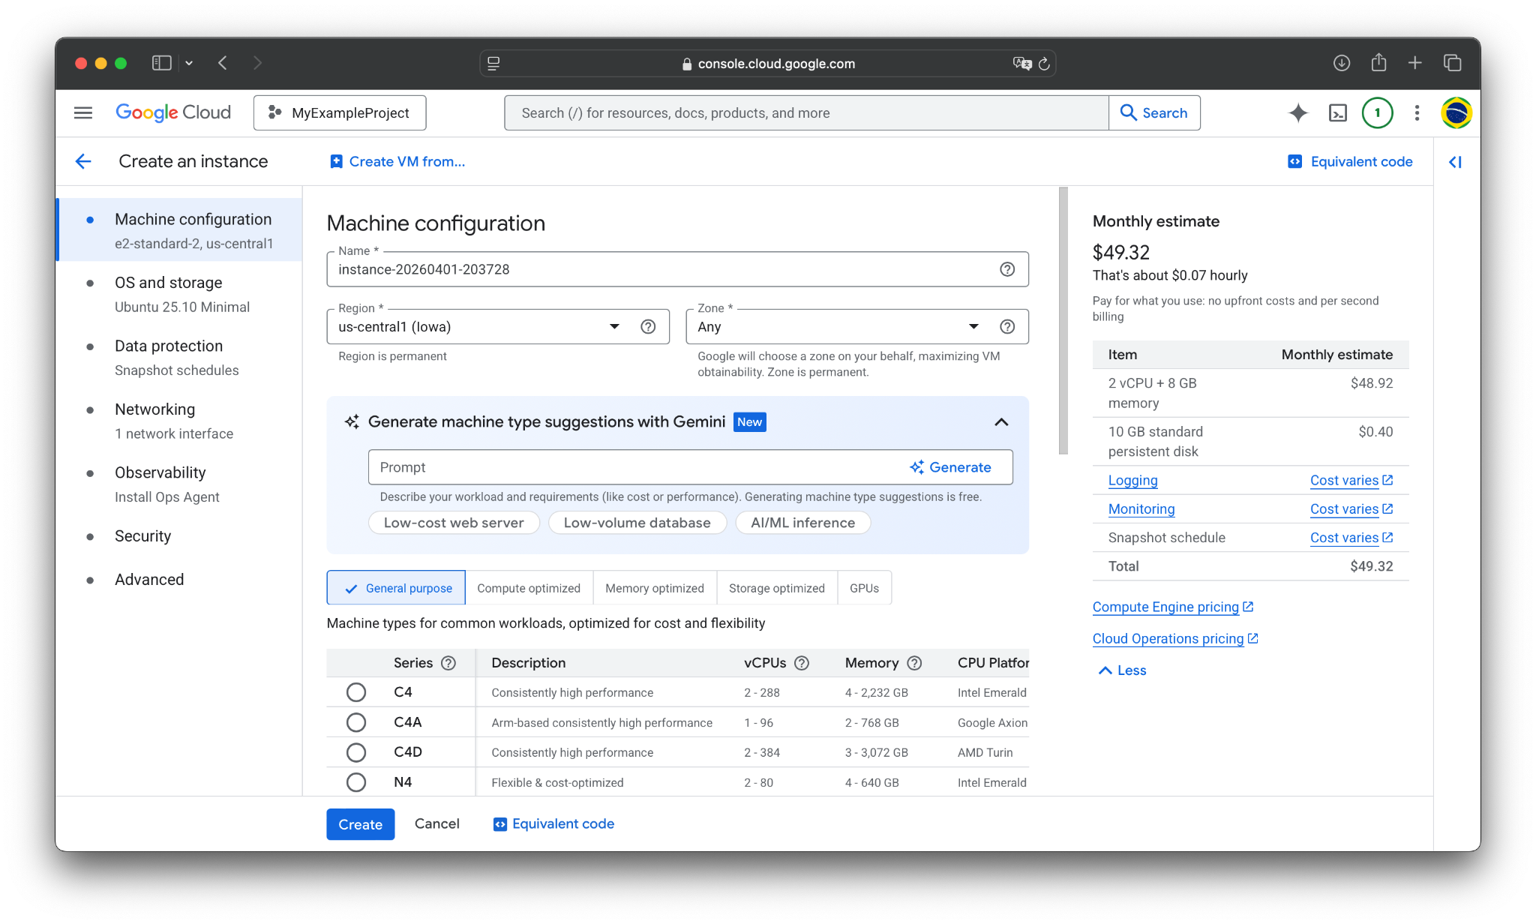
Now, we Create the VM.

Slide 78
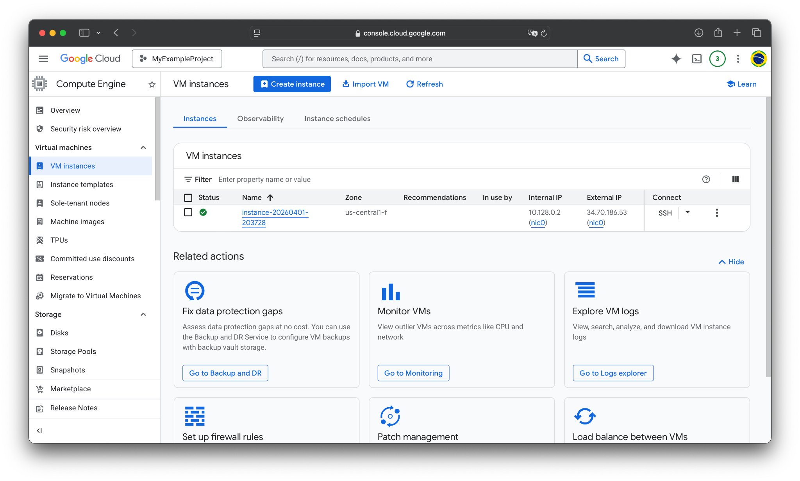
After a bit of time, it will deploy and the Status will become green.

Slide 79
This menu will list your created VM instances, along with their status, settings, and some metadata fields.

Slide 80
In particular, note the External IP.
It is the VM’s static IP (as long as the VM is alive). This is the address you use to connect to it via (TCP) sockets or SSH.

Slide 81
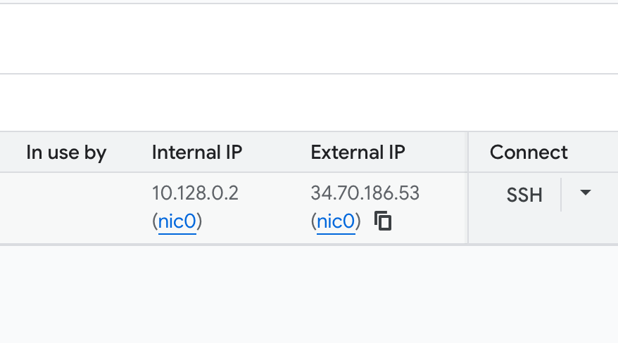
In particular, note the External IP.
Hovering over gives you the option to copy it by clicking. You will need to copy this IP later, so keep this window open.

Slide 82
WARNING: you will be billed continuously for as long as this VM is running!
To stop being billed for compute, you must stop or suspend it.
To stop being billed for storage or anything else, you must delete it.
This is covered at the end.
Do NOT skip this step, or your budget will run out fast!

Slide 83
Agenda
Redeeming credits
Logging into GCP
Creating a Virtual Machine instance in Compute Engine
Adding SSH Keys
Installing dependencies
Running your LinuxGetSsl application
Stopping / Suspending / Starting / Deleting instances

Slide 84
Connecting to a VM Instance (SSH)
Our VM instance is now up and running! So, how do we tell it what to run?
The simplest way is to just SSH into it, so you can use it like any other remote Linux server (e.g., CAEN, GreatLakes).
GCP provides two (main) ways to do so:
SSH via the web console
SSH from your local terminal

Slide 85
Connecting to a VM Instance (SSH)
Our VM instance is now up and running! So, how do we tell it what to run?
The simplest way is to just SSH into it, so you can use it like any other remote Linux server (e.g., CAEN, GreatLakes).
GCP provides two (main) ways to do so:
SSH via the web console
SSH from your local terminal

Slide 86
Click the SSH button, under Connect.

Slide 87
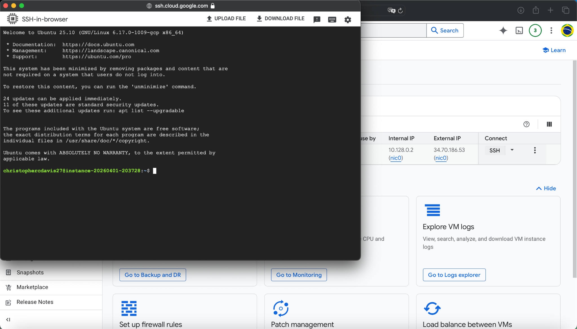
Now you are connected.

Slide 88
Connecting to a VM Instance (SSH)
Our VM instance is now up and running! So, how do we tell it what to run?
The simplest way is to just SSH into it, so you can use it like any other remote Linux server (e.g., CAEN, GreatLakes).
GCP provides two (main) ways to do so:
SSH via the web console
SSH from your local terminal

Slide 89
Connecting to a VM Instance (SSH – local)
The other—probably preferred—method is to SSH directly from your local device.
Here are the steps to do that:
Create a local SSH key. For instance:
ssh-keygen -t rsa -b 4096 -f ~/.ssh/gcp_key -C "YOUR_USERNAME"
Replace YOUR_USERNAME with the exact username you want to log on to the VM with.
Copy the SSH key you made
I.e., copy the output of cat ~/.ssh/gcp_key.pub
Paste it as a new entry into the VM’s SSH key settings
Connect to the VM
ssh -i ~/.ssh/gcp_key YOUR_USERNAME@VM_EXTERNAL_IP_ADDRESS

Slide 90
Connecting to a VM Instance (SSH – local)
The other—probably preferred—method is to SSH directly from your local device.
Here are the steps to do that:
Create a local SSH key. For instance:
ssh-keygen -t rsa -b 4096 -f ~/.ssh/gcp_key -C "YOUR_USERNAME"
Replace YOUR_USERNAME with the exact username you want to log on to the VM with.
Copy the SSH key you made
I.e., copy the output of cat ~/.ssh/gcp_key.pub
Paste it as a new entry into the VM’s SSH key settings
Connect to the VM
ssh -i ~/.ssh/gcp_key YOUR_USERNAME@VM_EXTERNAL_IP_ADDRESS

Slide 91
Connecting to a VM Instance (SSH – local)
The other—probably preferred—method is to SSH directly from your local device.
Here are the steps to do that:
Create a local SSH key. For instance:
ssh-keygen -t rsa -b 4096 -f ~/.ssh/gcp_key -C "YOUR_USERNAME"
Replace YOUR_USERNAME with the exact username you want to log on to the VM with.
Copy the SSH key you made
I.e., copy the output of cat ~/.ssh/gcp_key.pub
Paste it as a new entry into the VM’s SSH key settings
Connect to the VM
ssh -i ~/.ssh/gcp_key YOUR_USERNAME@VM_EXTERNAL_IP_ADDRESS

Slide 92
Click the VM’s name to configure it.

Slide 93
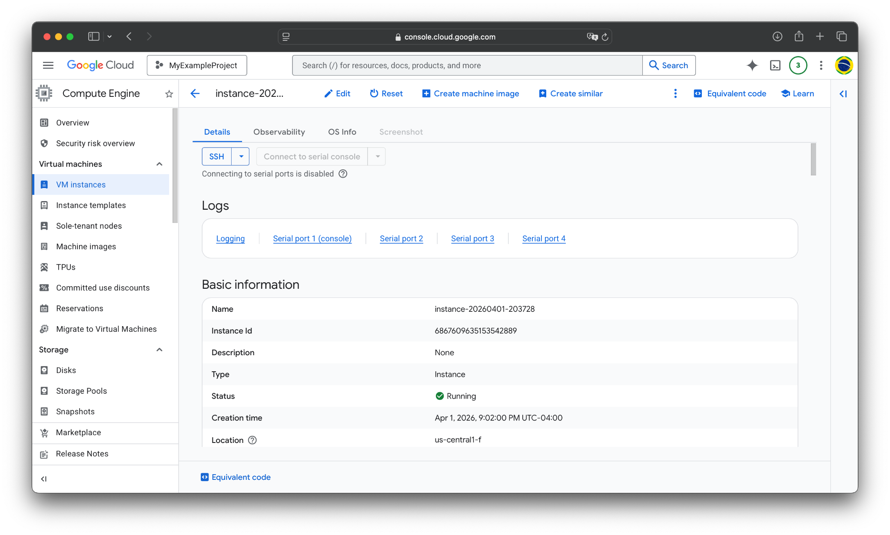
Click on Edit.

Slide 94
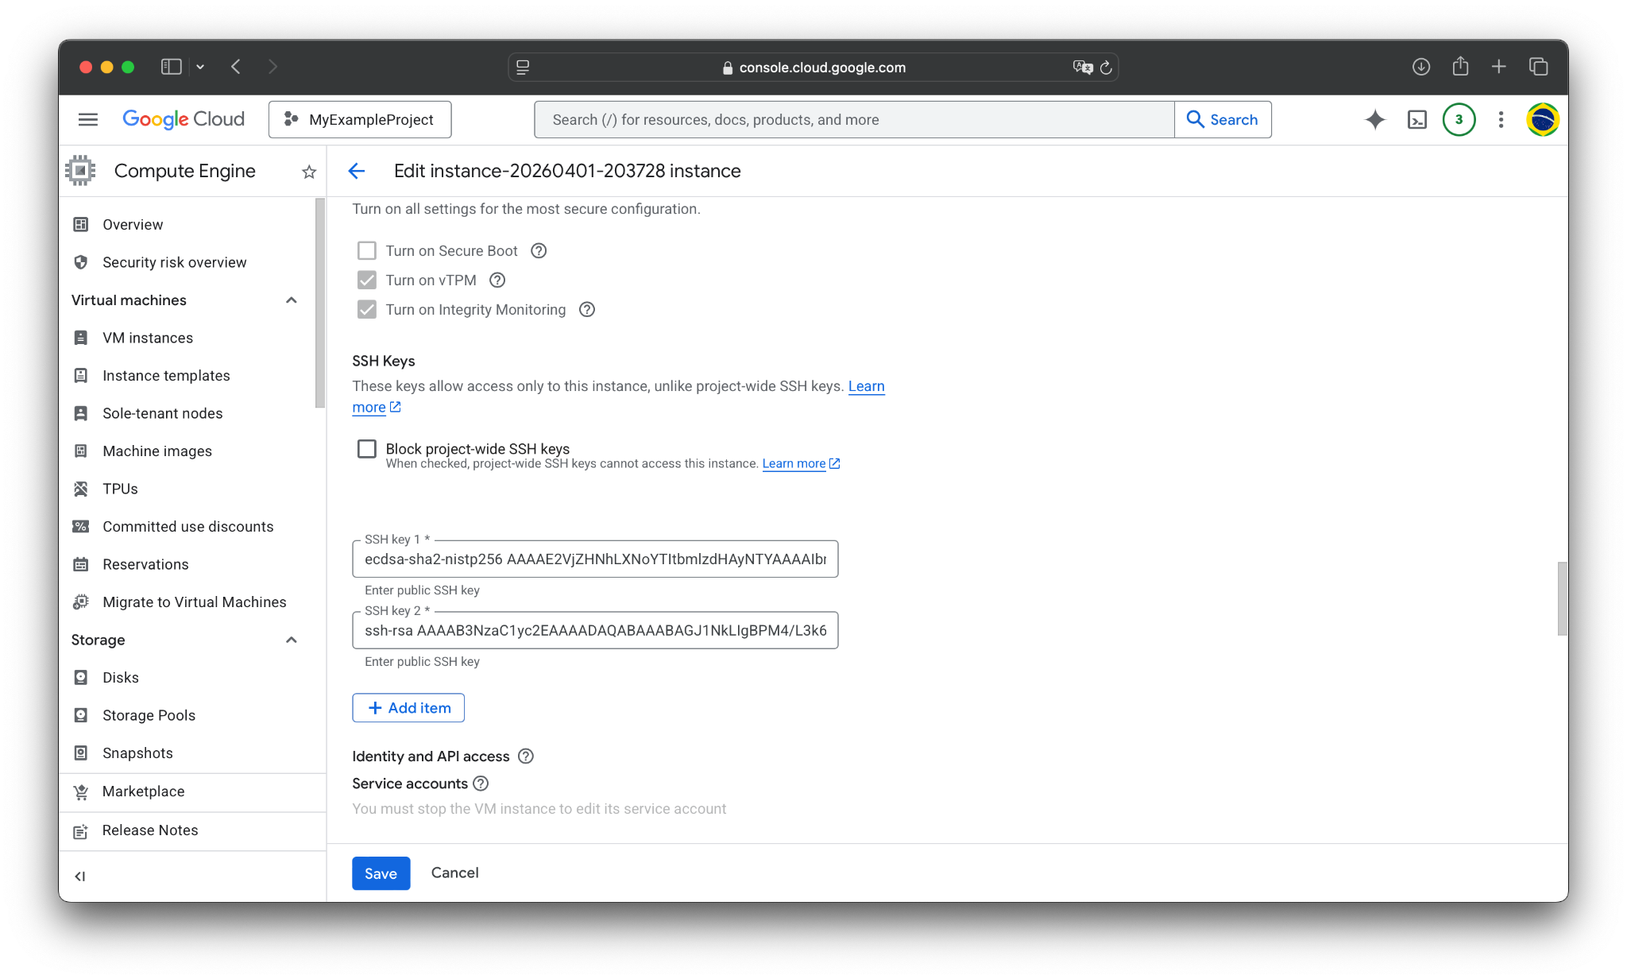
Scroll down to SSH Keys and add a new one via Add item.

Slide 95
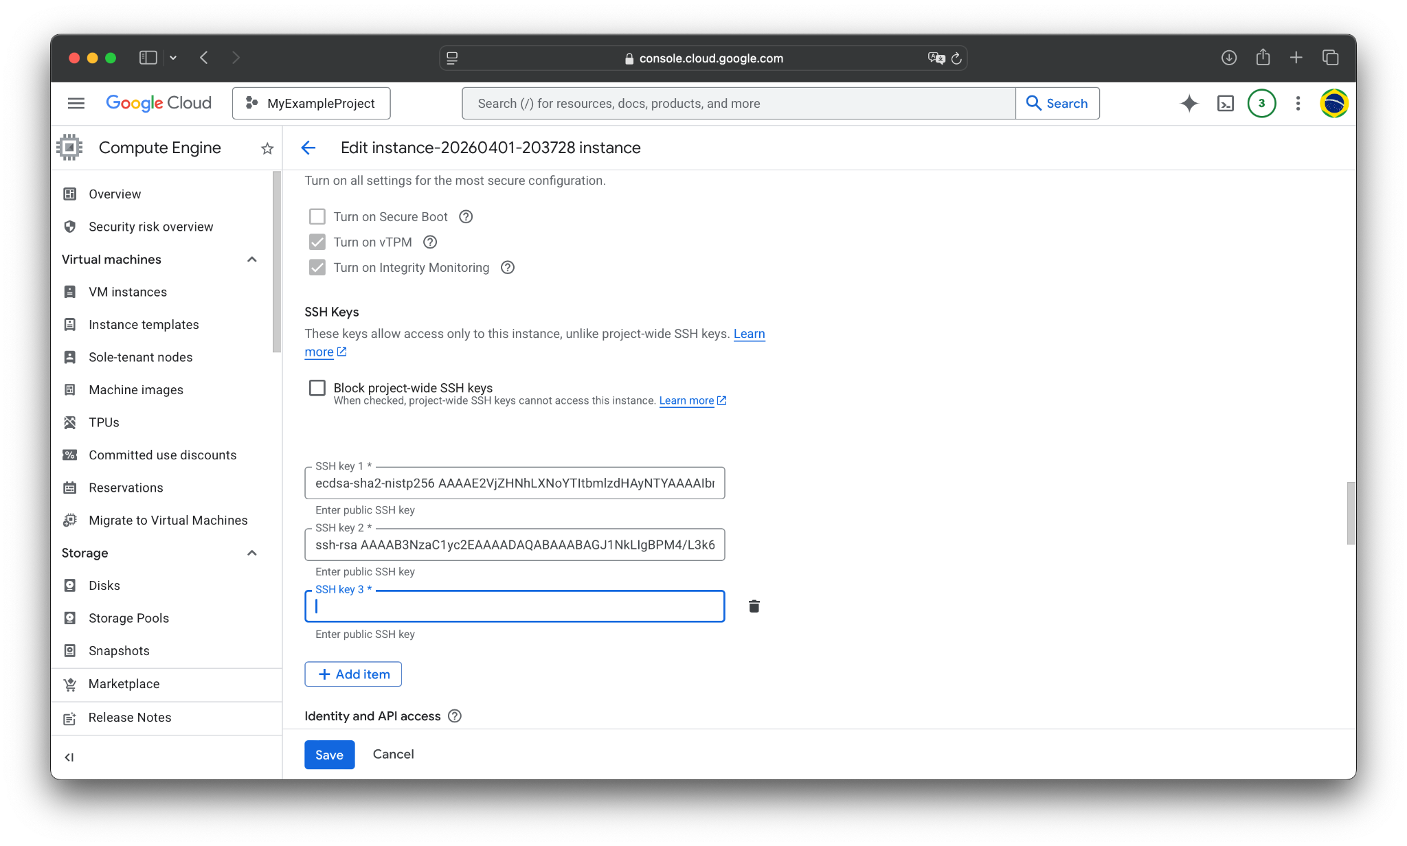
Paste your key here.

Slide 96
Then, Save the new settings.

Slide 97
Connecting to a VM Instance (SSH – local)
The other—probably preferred—method is to SSH directly from your local device.
Here are the steps to do that:
Create a local SSH key. For instance:
ssh-keygen -t rsa -b 4096 -f ~/.ssh/gcp_key -C "YOUR_USERNAME"
Replace YOUR_USERNAME with the exact username you want to log on to the VM with.
Copy the SSH key you made
I.e., copy the output of cat ~/.ssh/gcp_key.pub
Paste it as a new entry into the VM’s SSH key settings
Connect to the VM
ssh -i ~/.ssh/gcp_key YOUR_USERNAME@VM_EXTERNAL_IP_ADDRESS

Slide 98
Connecting to a VM Instance (SSH – local)
Connect to the VM via SSH:
ssh -i ~/.ssh/gcp_key YOUR_USERNAME@VM_EXTERNAL_IP_ADDRESS
For example:
ssh -i ~/.ssh/gcp_key nhamilton@127.0.0.1

Slide 99
Agenda
Redeeming credits
Logging into GCP
Creating a Virtual Machine instance in Compute Engine
Adding SSH Keys
Installing dependencies
Running your LinuxGetSsl application
Stopping / Suspending / Starting / Deleting instances

Slide 100
Linux Environments
The OS images that Google provide are minimal: you will have to install any dependencies or tools you plan on using.
Luckily, this is usually pretty simple for common libraries / applications via the OS’ installed package manager.
If you used the default Debian or Ubuntu GCP images (like in this tutorial), then the package manager will be Advanced Package Tool (apt).
I will now go over installing common dependencies for Linux C++ applications (e.g., your LinuxGetSsl) on the remote server.

Slide 101
Install Common C++ Dependencies (Ubuntu / Debian)
Step 1: Update your package lists
Always do this on a fresh VM to ensure you download the latest versions of the packages.
sudo apt update && sudo apt upgrade -y
Step 2: Install common build and tooling dependencies
There is a build-essential meta package that contains g++/gcc, make, and libc6-dev (std library headers). You can add any other essential tools, like git and cmake, or maybe gdb.
sudo apt install -y build-essential cmake git gdb
Step 3: Verify installation
Make sure the C++ compiler is installed (and at a reasonable version).
g++ --version
cmake --version

Slide 102
Install Application-Specific Dependencies
Step 1: Install Application-Specifc Dependencies
Our LinuxGetSsl uses two 3rd party dependencies: OpenSSL and ZLib. So, we install them:
sudo apt install -y libssl-dev zlib1g-dev
Step 2: Make Location on Remote for our Code
We can also set up a location to hold our LinuxGetSsl project:
mkdir LinuxGetSsl

Slide 103
Moving Code to Remote Server
Step 1: Go to Local Source Location
On a new local terminal window, travel with cd to the directory containing your LinuxGetSsl code. It should be the root, containing the Makefile and all of the .cpp sources required to build.
cd local/path/to/LinuxGetSsl
Step 2: Copy over your Code (via scp)
Now, we copy this code over. We will use scp, but rsync and others work, too.
scp -i ~/.ssh/gcp_key LinuxGetSsl.cpp Makefile {USER}@{IP}:LinuxGetSsl
Where again {USER} is the username you set when making the SSH key, and {IP} is the external ip of the VM instance that you can copy from the GCP console.

Slide 104
Building & Running LinuxGetSsl
Now, your code should be on the remote environment.
You can verify this from the remote SSH terminal:
ls ~/LinuxGetSsl
cd LinuxGetSsl
You can then build and run it like usual!
Try running make and then using LinuxGetSsl to fetch a webpage.
E.g., https://hamiltonlabs.com
./LinuxGetSsl https://hamiltonlabs.com

Slide 105
Agenda
Redeeming credits
Logging into GCP
Creating a Virtual Machine instance in Compute Engine
Adding SSH Keys
Installing dependencies
Running your LinuxGetSsl application
Stopping / Suspending / Starting / Deleting instances

Slide 106
VM Lifetime
Now you’re fully set up with a basic VM!
As you’ve probably noticed before, running a VM can be expensive, especially if you don’t actually need to run it 24/7.
Luckily, there are ways to save money if you don’t need your VM active. These are the options:
Stop: shuts off VM, losing anything in RAM or local SSDs
Suspend: freezes VM, preserving memory and local SSDs
Delete: deletes the VM and all of its resources
Note: even while stopped/suspended, you will still be billed for storage!

Slide 107
Select the VM you want to stop/suspend/delete.

Slide 108
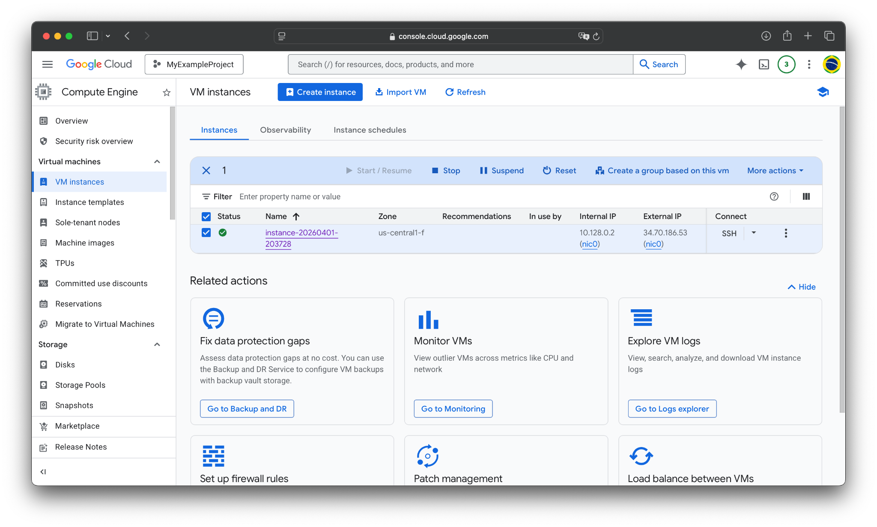
If you click Stop or Suspend, it will temporarily pause the VM.
You won’t be billed for compute, but you will be billed for storage.

Slide 109
Start / Resume resumes the VM after stopping/suspending.

Slide 110
To delete the VM, click the three dots here to open a menu.

Slide 111
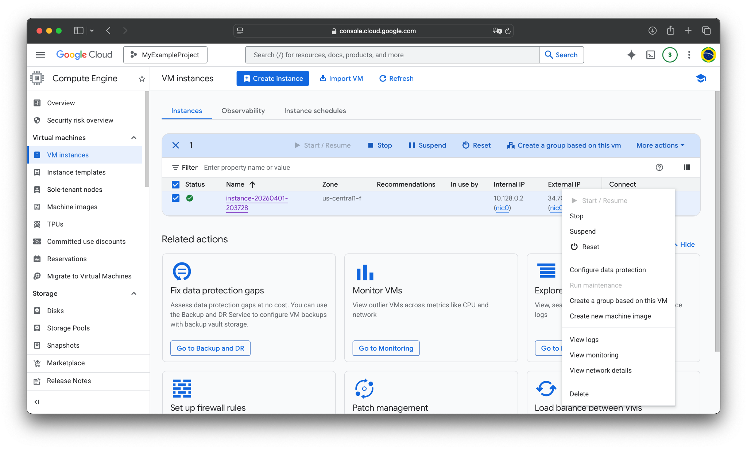
Hitting Delete deletes the instance.
This deletes all associated resources, and you will stop being billed for this instance completely.

Slide 112
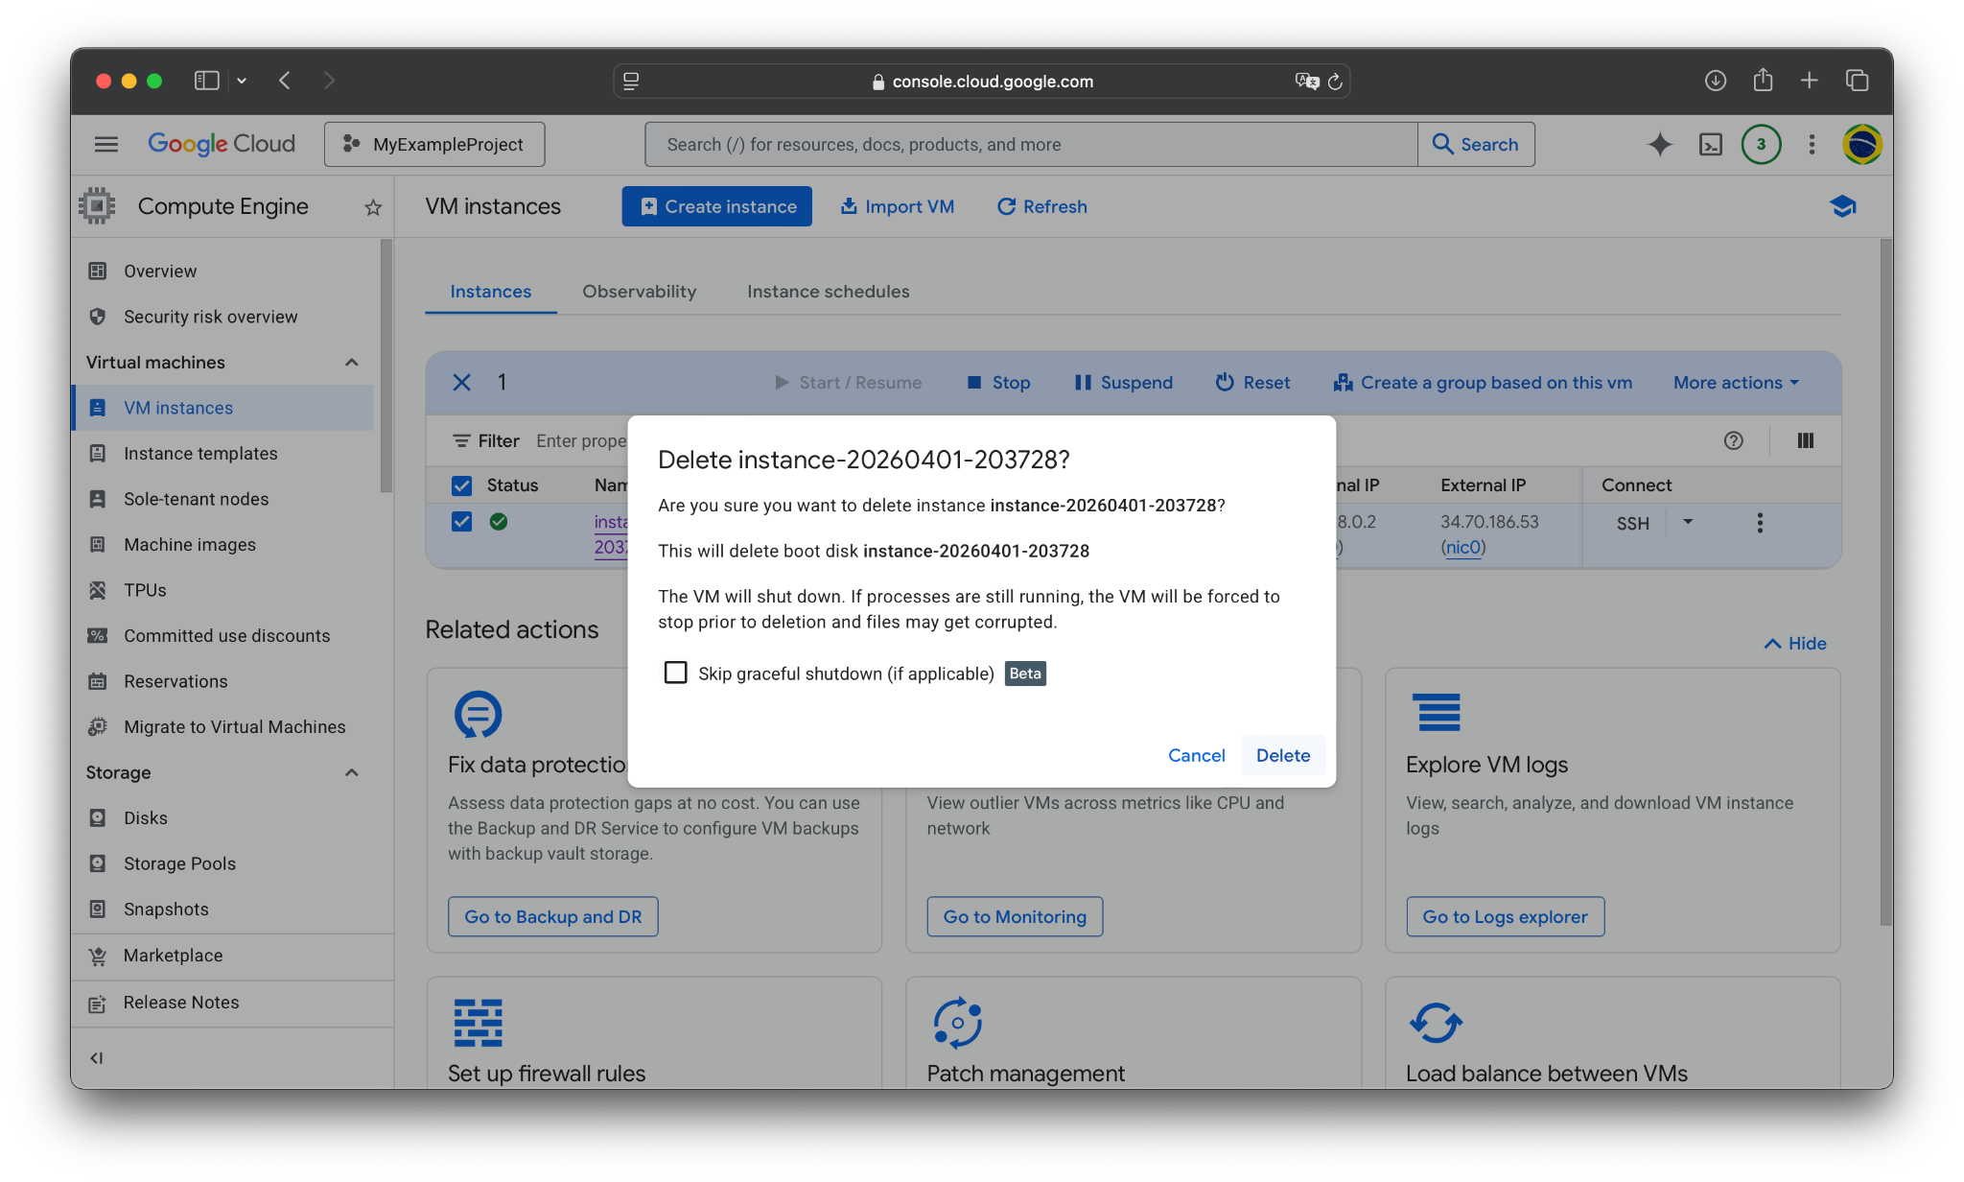

Slide 113

After a while, the instance will finish deletion, and will disappear from the VM instances menu.

Slide 114
VM Summary
You now know how to create, configure, pause, and kill a custom VM on GCP.
Doing all this by hand (as in this tutorial) is simple enough for most development and small-scale production environments.
However, there are more efficient / reproducible ways of managing these instances, which might be nice for a bunch of copies of a distributed server, such as the gcloud CLI. There are even Continuous Integration (CI) utilities that can interface directly with your (Github) source code.
I will cover all of these in a later guide, but you now have enough to begin your GCP development.

